Slide 1
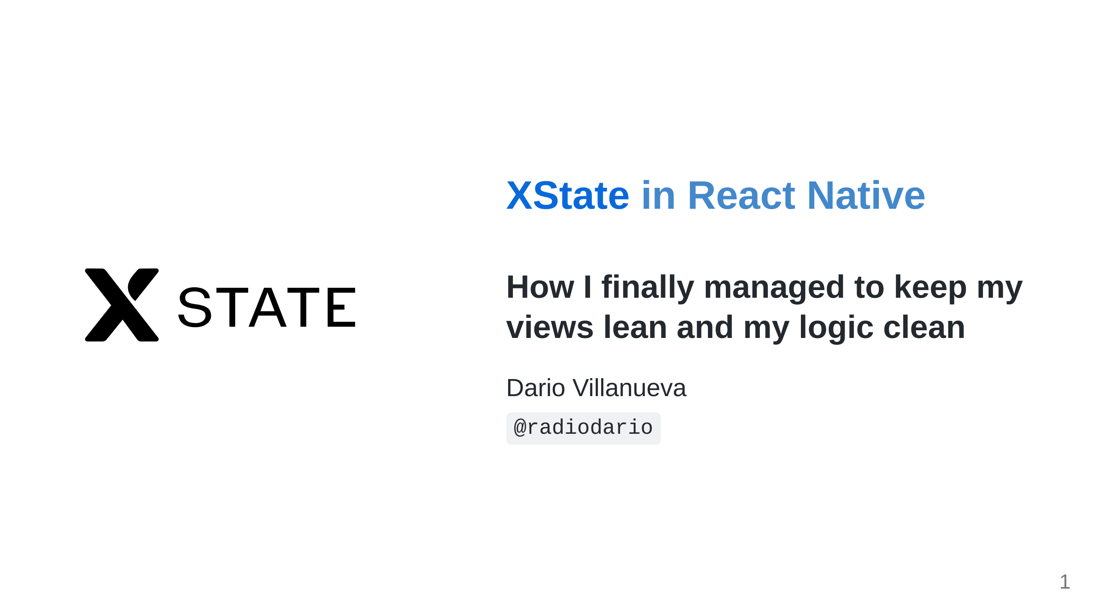

Slide 2


Slide 3
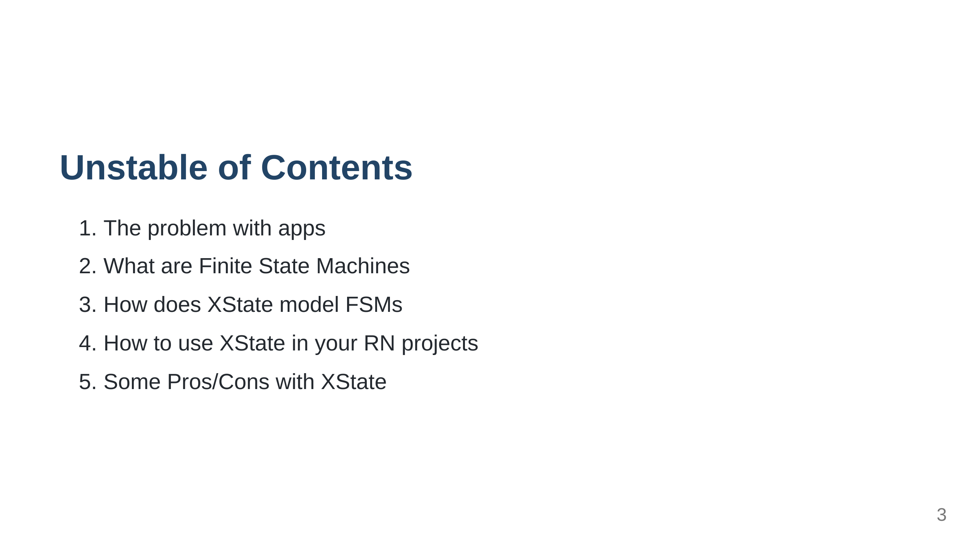

Slide 4


Slide 5

Notes:
Who can tell me what this is

Slide 6
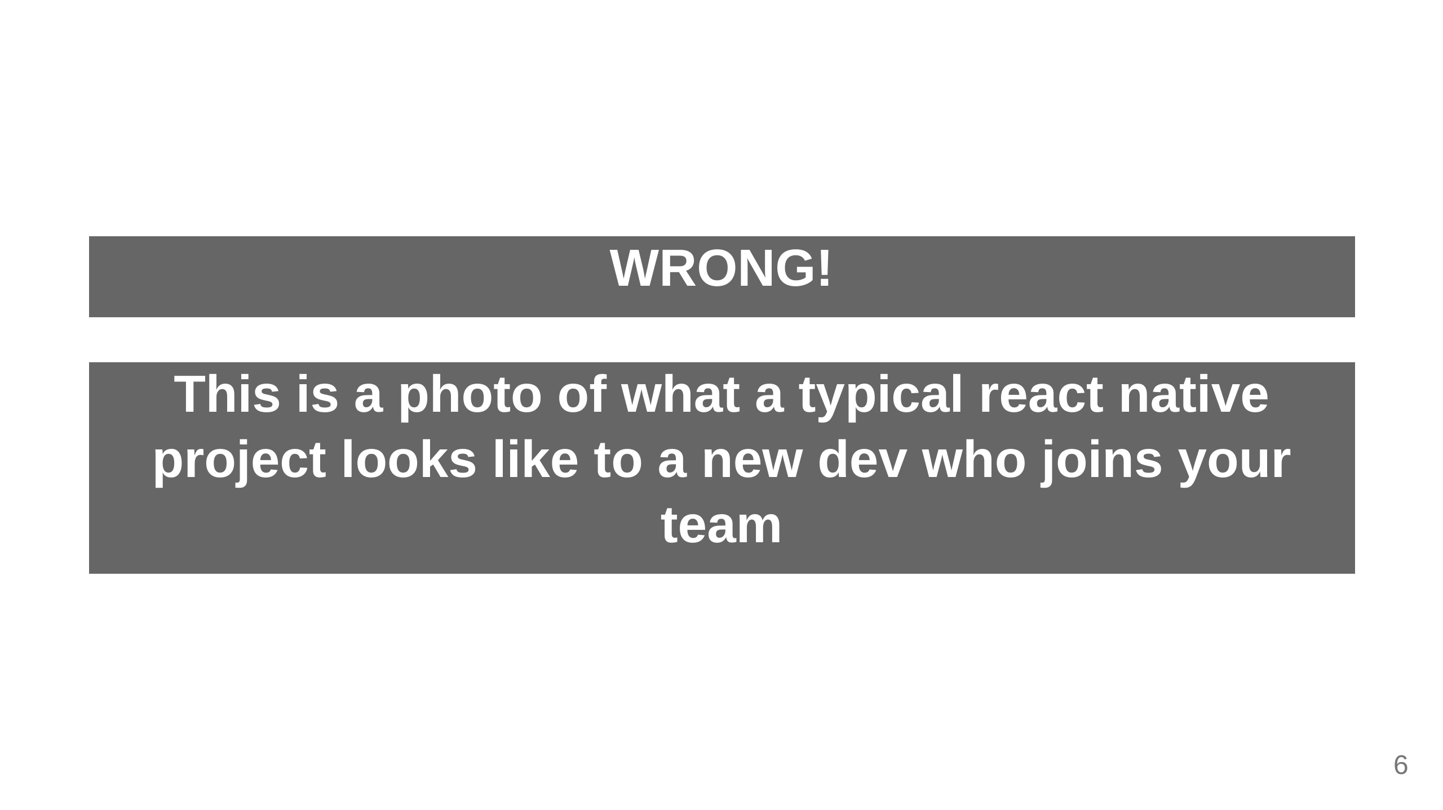

Slide 7

Notes:
Who can tell me what this is

Slide 8
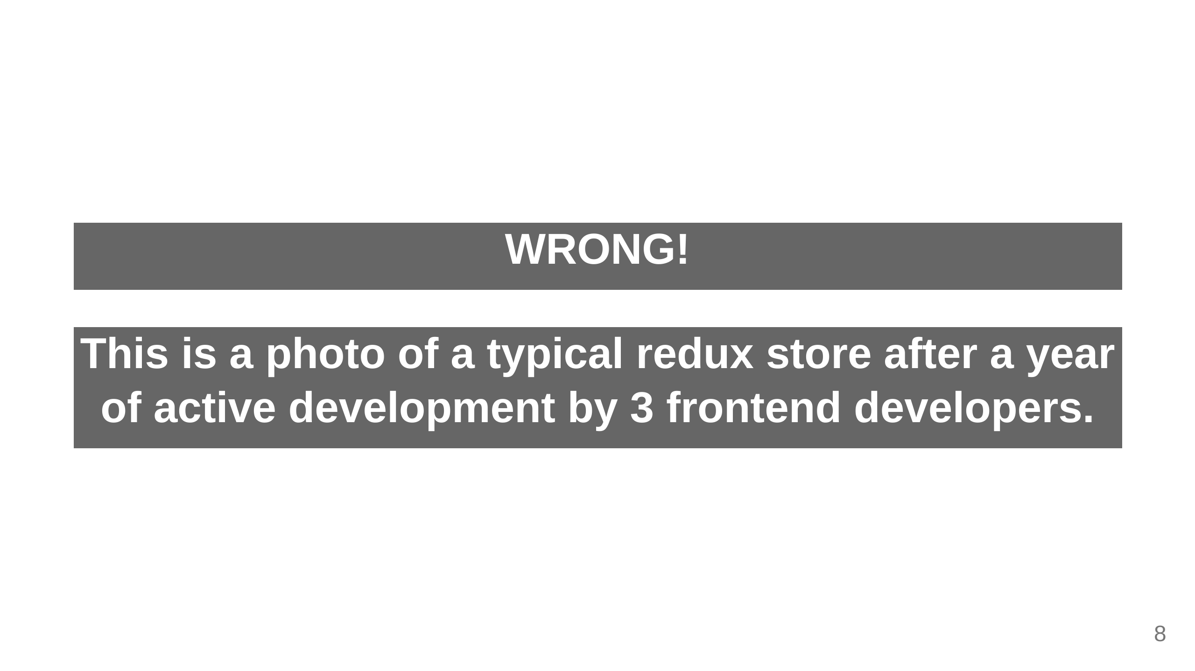

Slide 9

Notes:
Who can tell me what this is

Slide 10
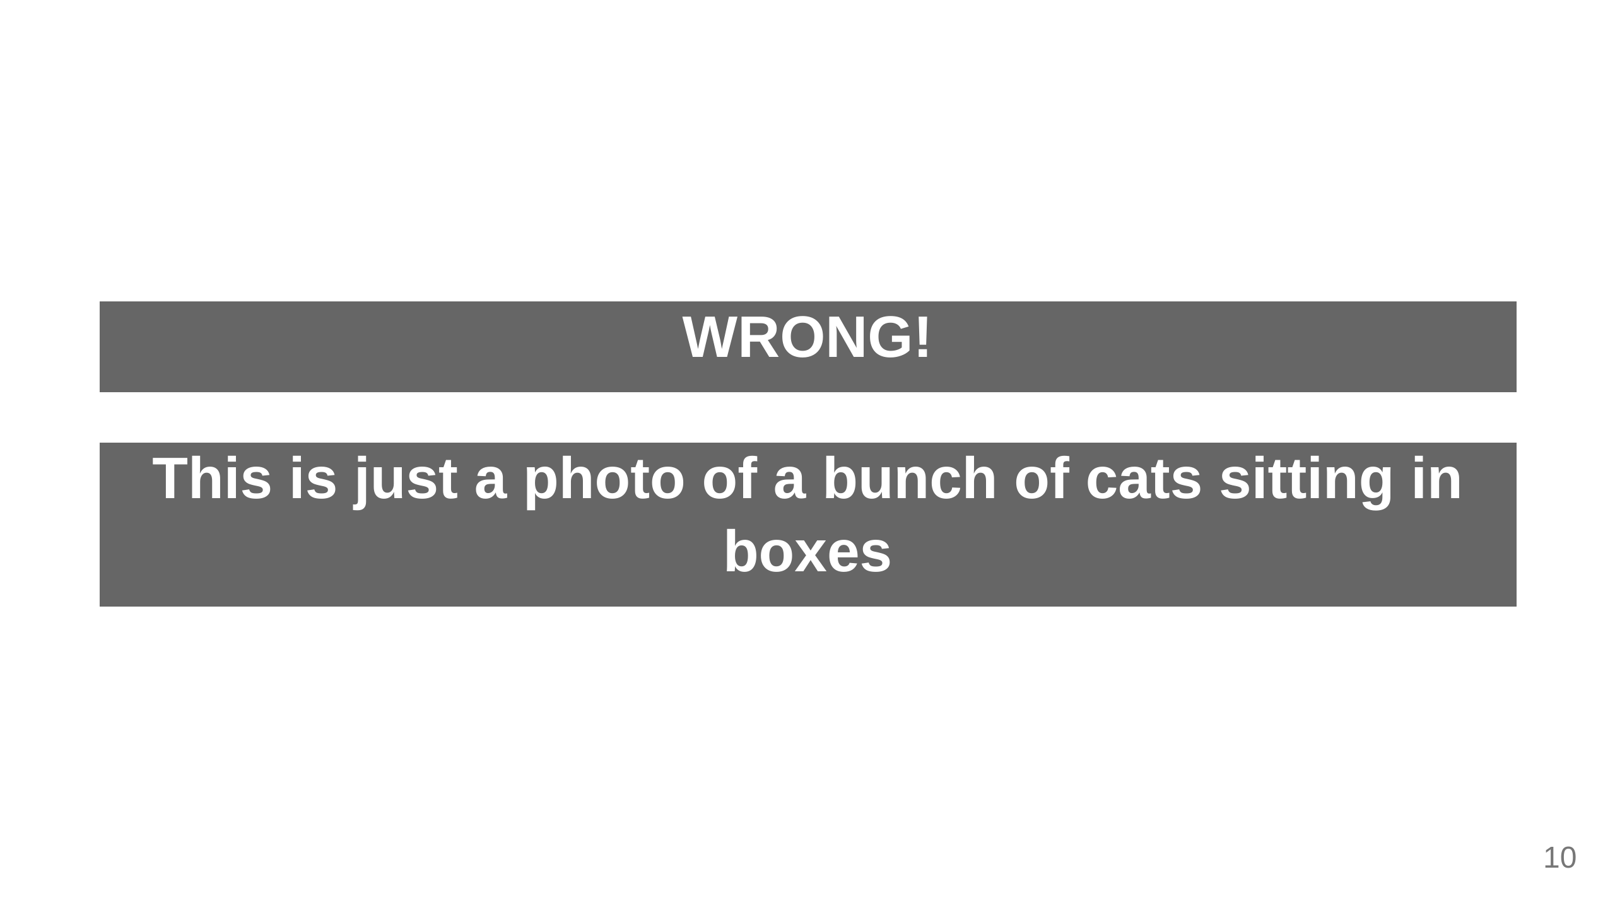

Slide 11


Slide 12
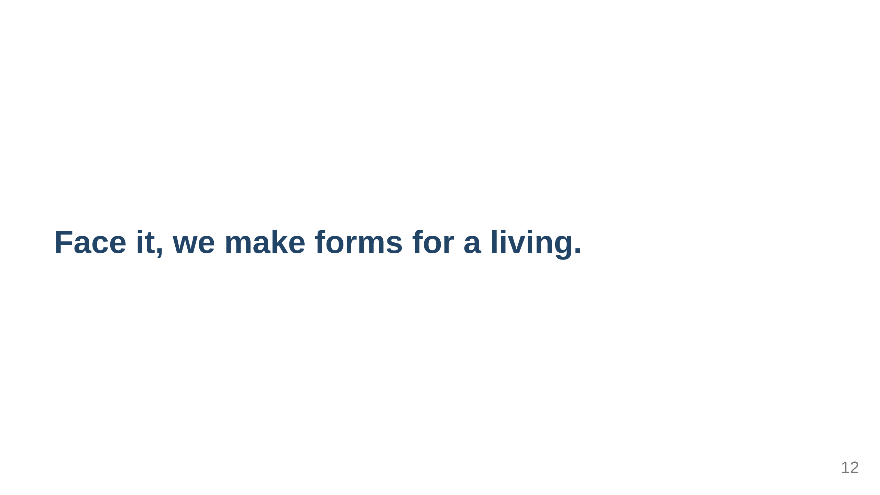

Slide 13


Slide 14
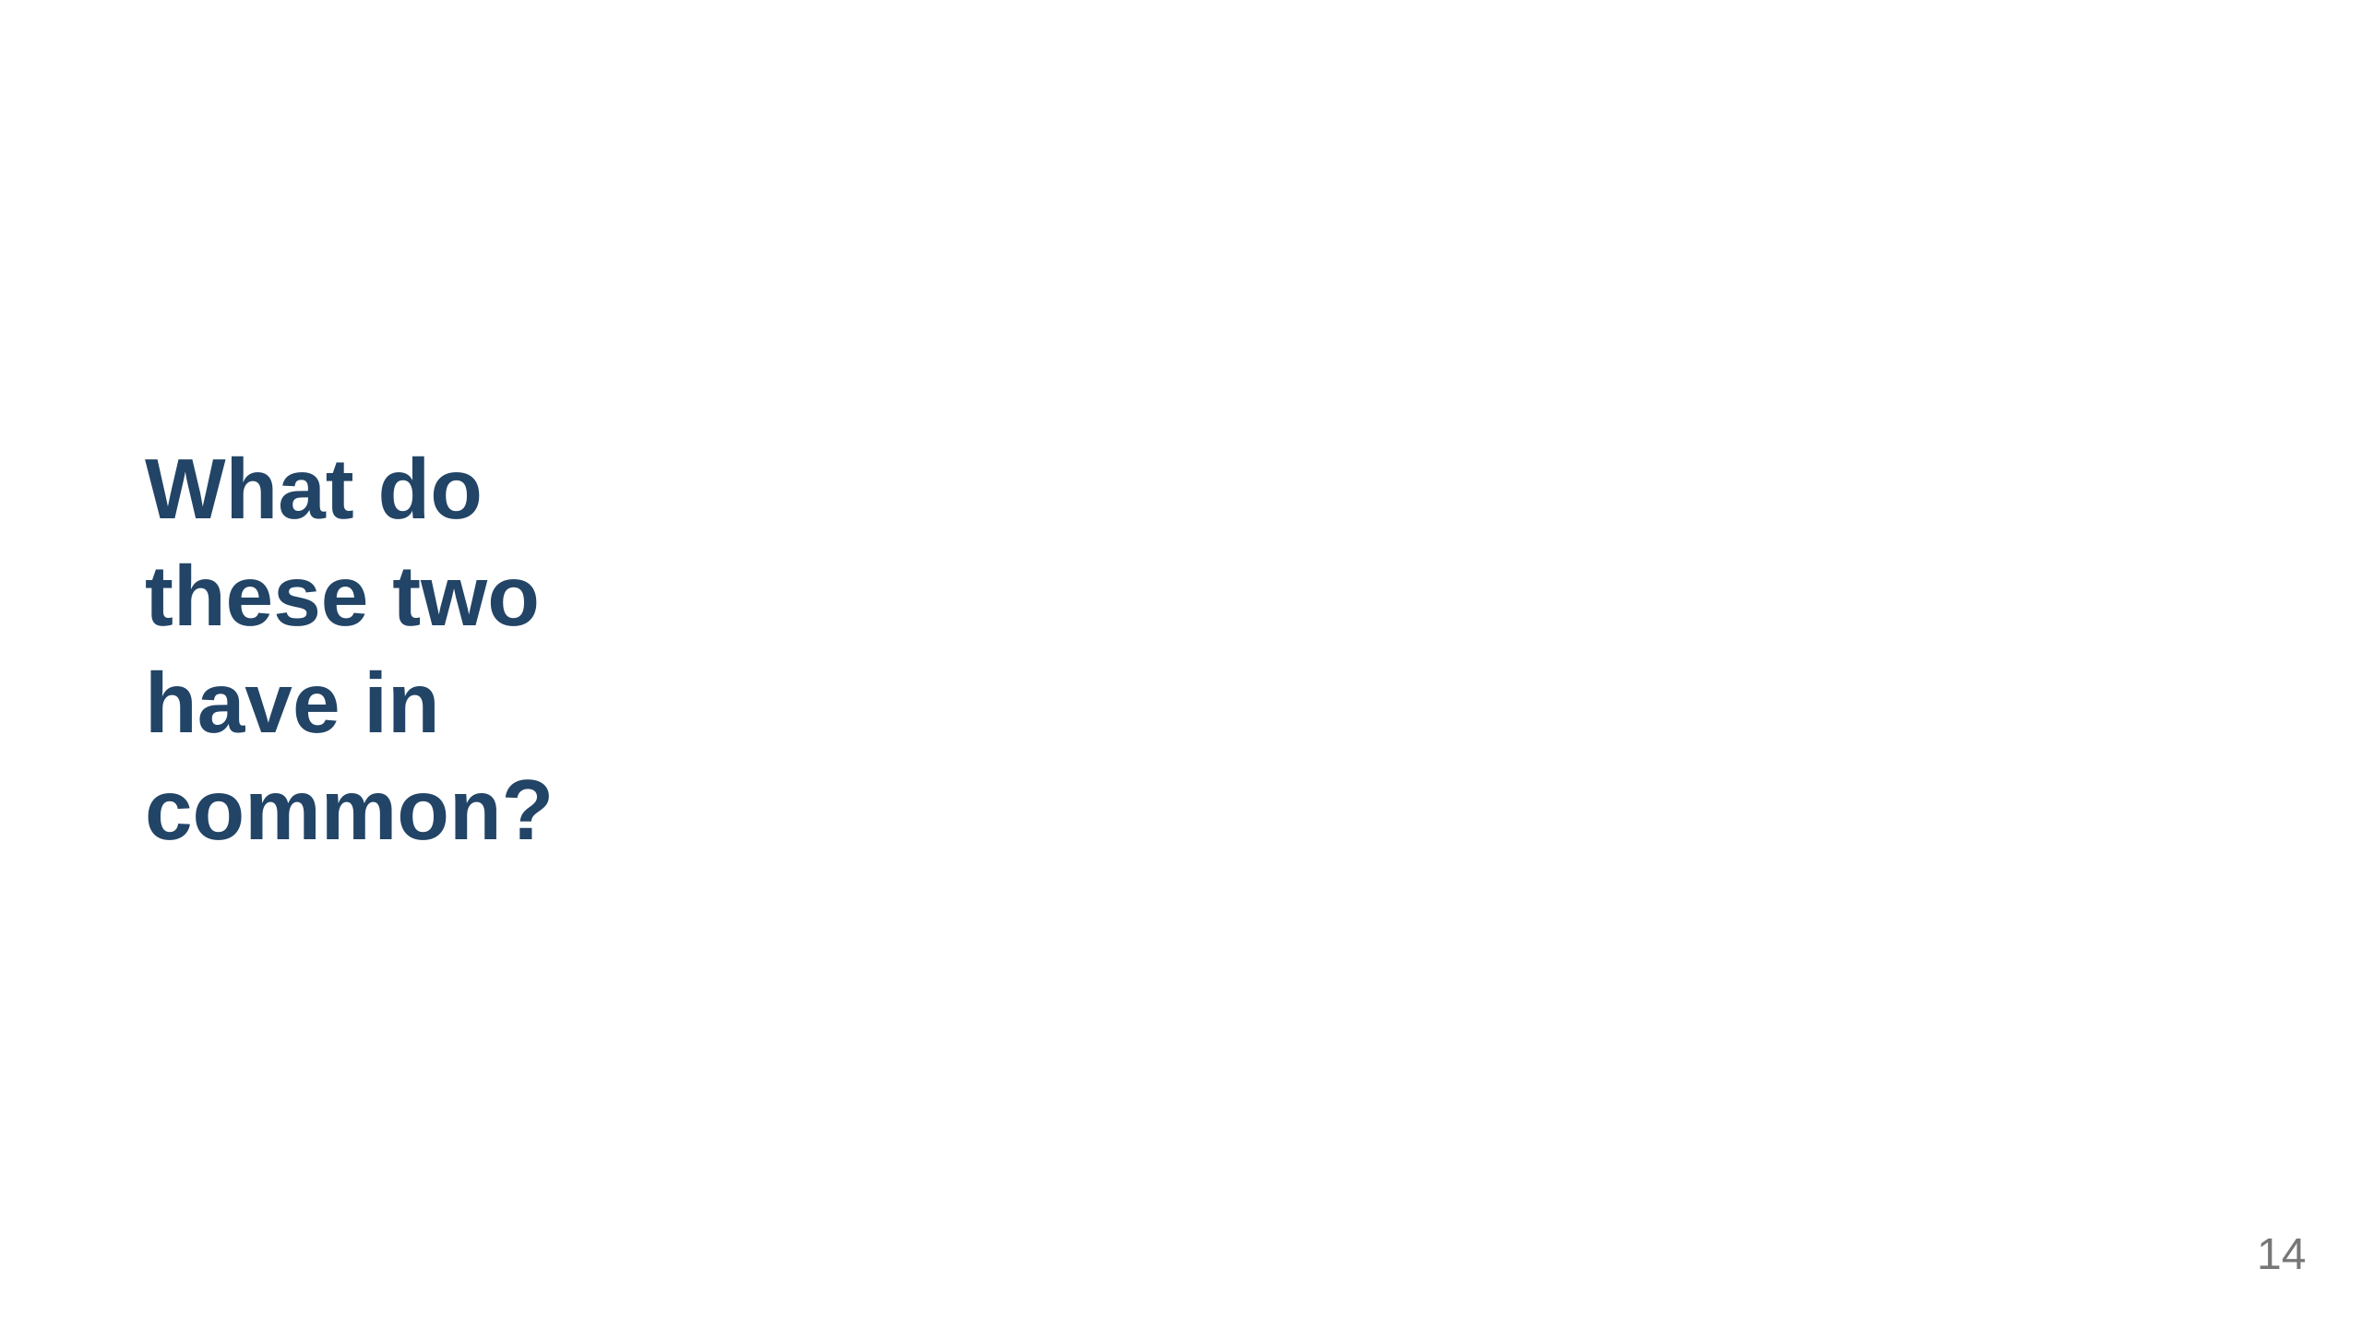
Notes:
They can all be simulated by state machines

Slide 15
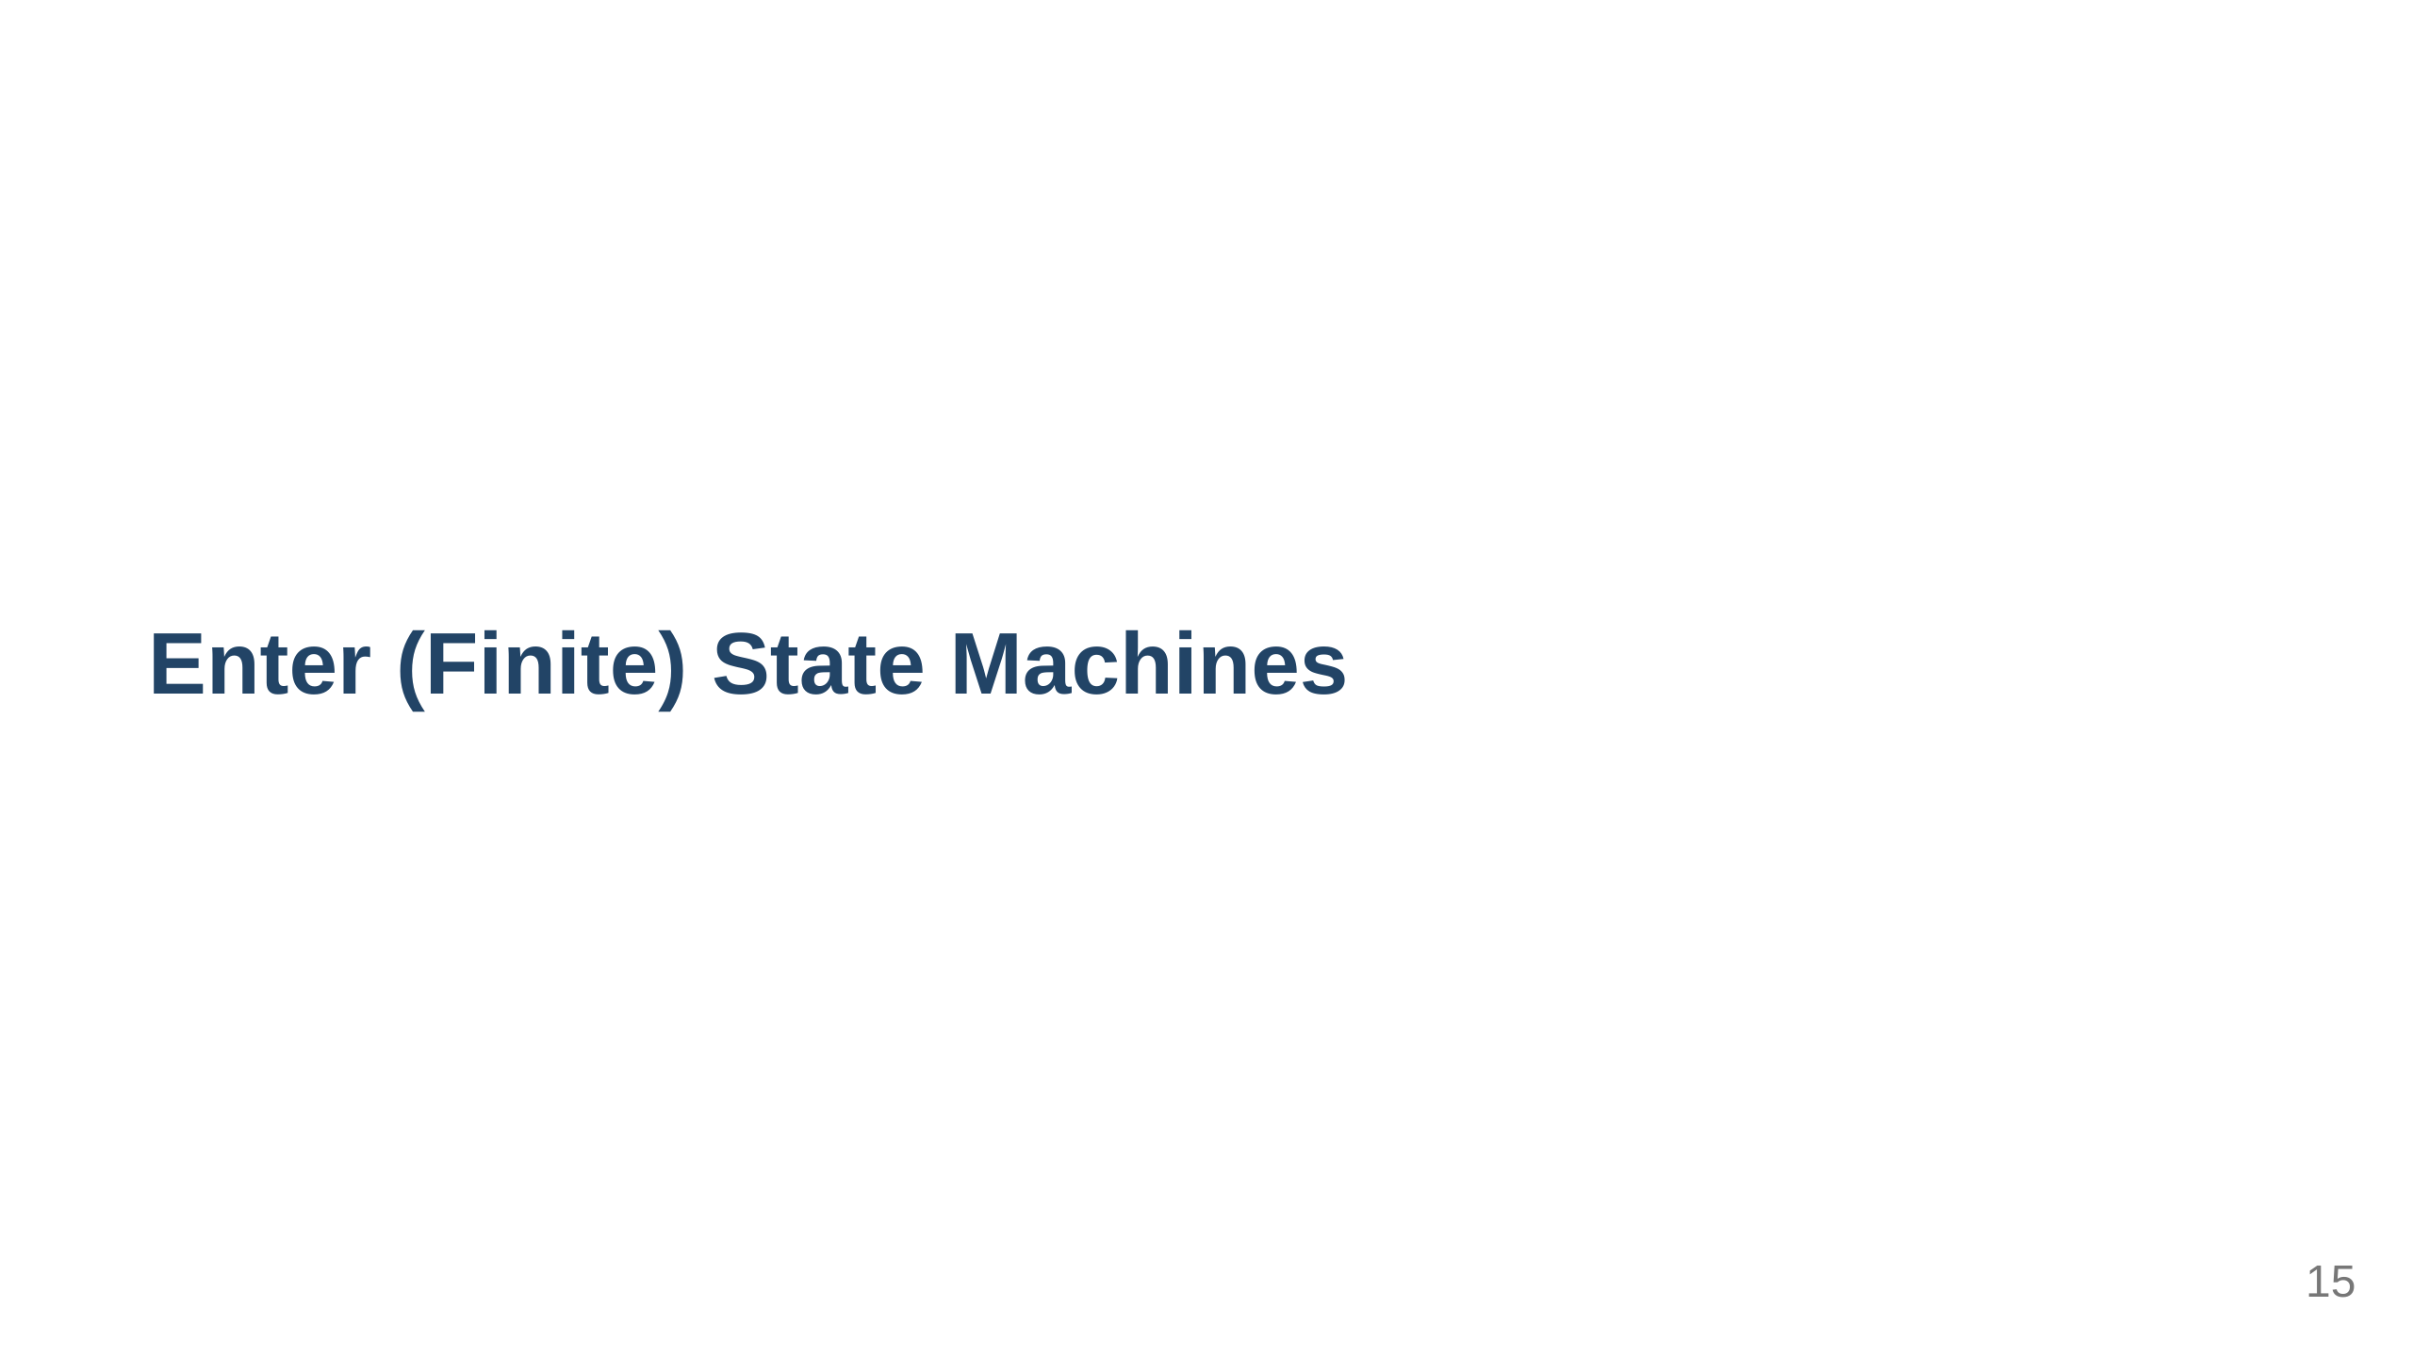
Notes:
ask anyone if they did informatics 101 - A finite state machine (sometimes called a finite state automaton) is a computation model that can be implemented with hardware or software and can be used to simulate sequential logic and some computer programs. - Finite state machines can be used to model problems in many fields including mathematics, artificial intelligence, games, and linguistics. - Finite state automata generate regular languages.

Slide 16
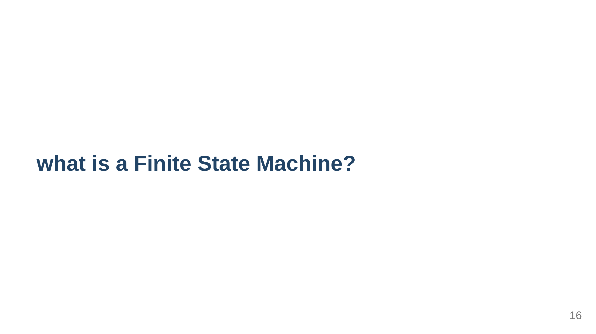
Notes:
A FSM is a mathematical model of computation. It is an abstract machine that can be in exactly one of a finite number of states at any given time. it can change from one state to another in response to some inputs; the change from one state to another is called a transition.[1] An FSM is defined by a list of its states, its initial state, and the inputs that trigger each transition

Slide 17
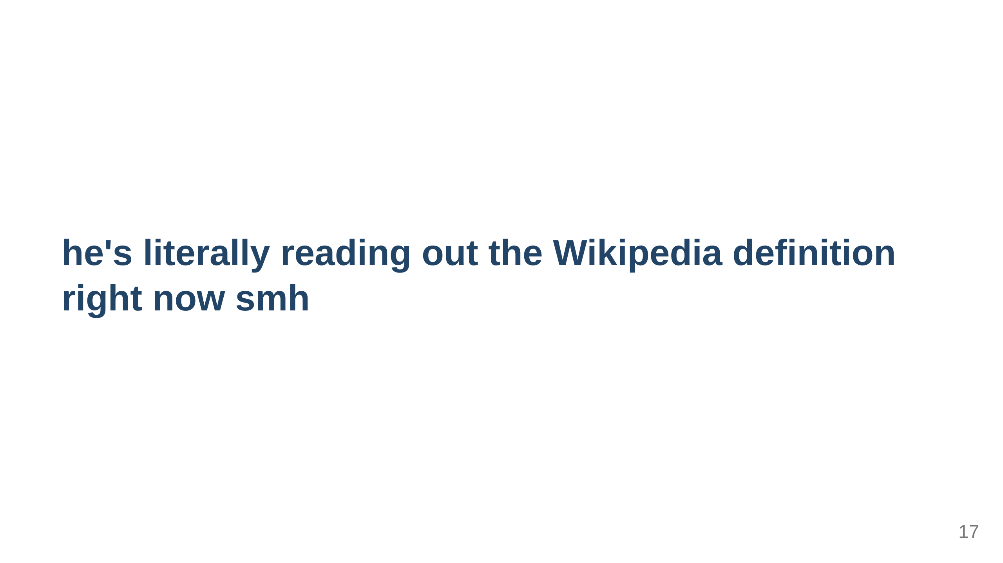
Notes:
A FSM is a mathematical model of computation. It is an abstract machine that can be in exactly one of a finite number of states at any given time. it can change from one state to another in response to some inputs; the change from one state to another is called a transition.[1] An FSM is defined by a list of its states, its initial state, and the inputs that trigger each transition

Slide 18

Notes:
show the states initial state the transitions final state

Slide 19
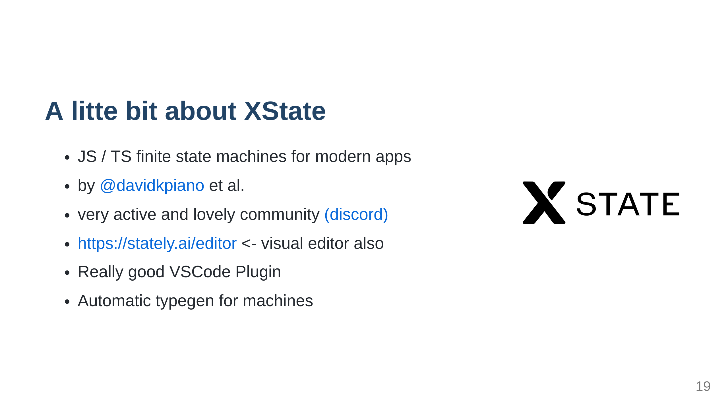
Notes:
- by

Slide 20
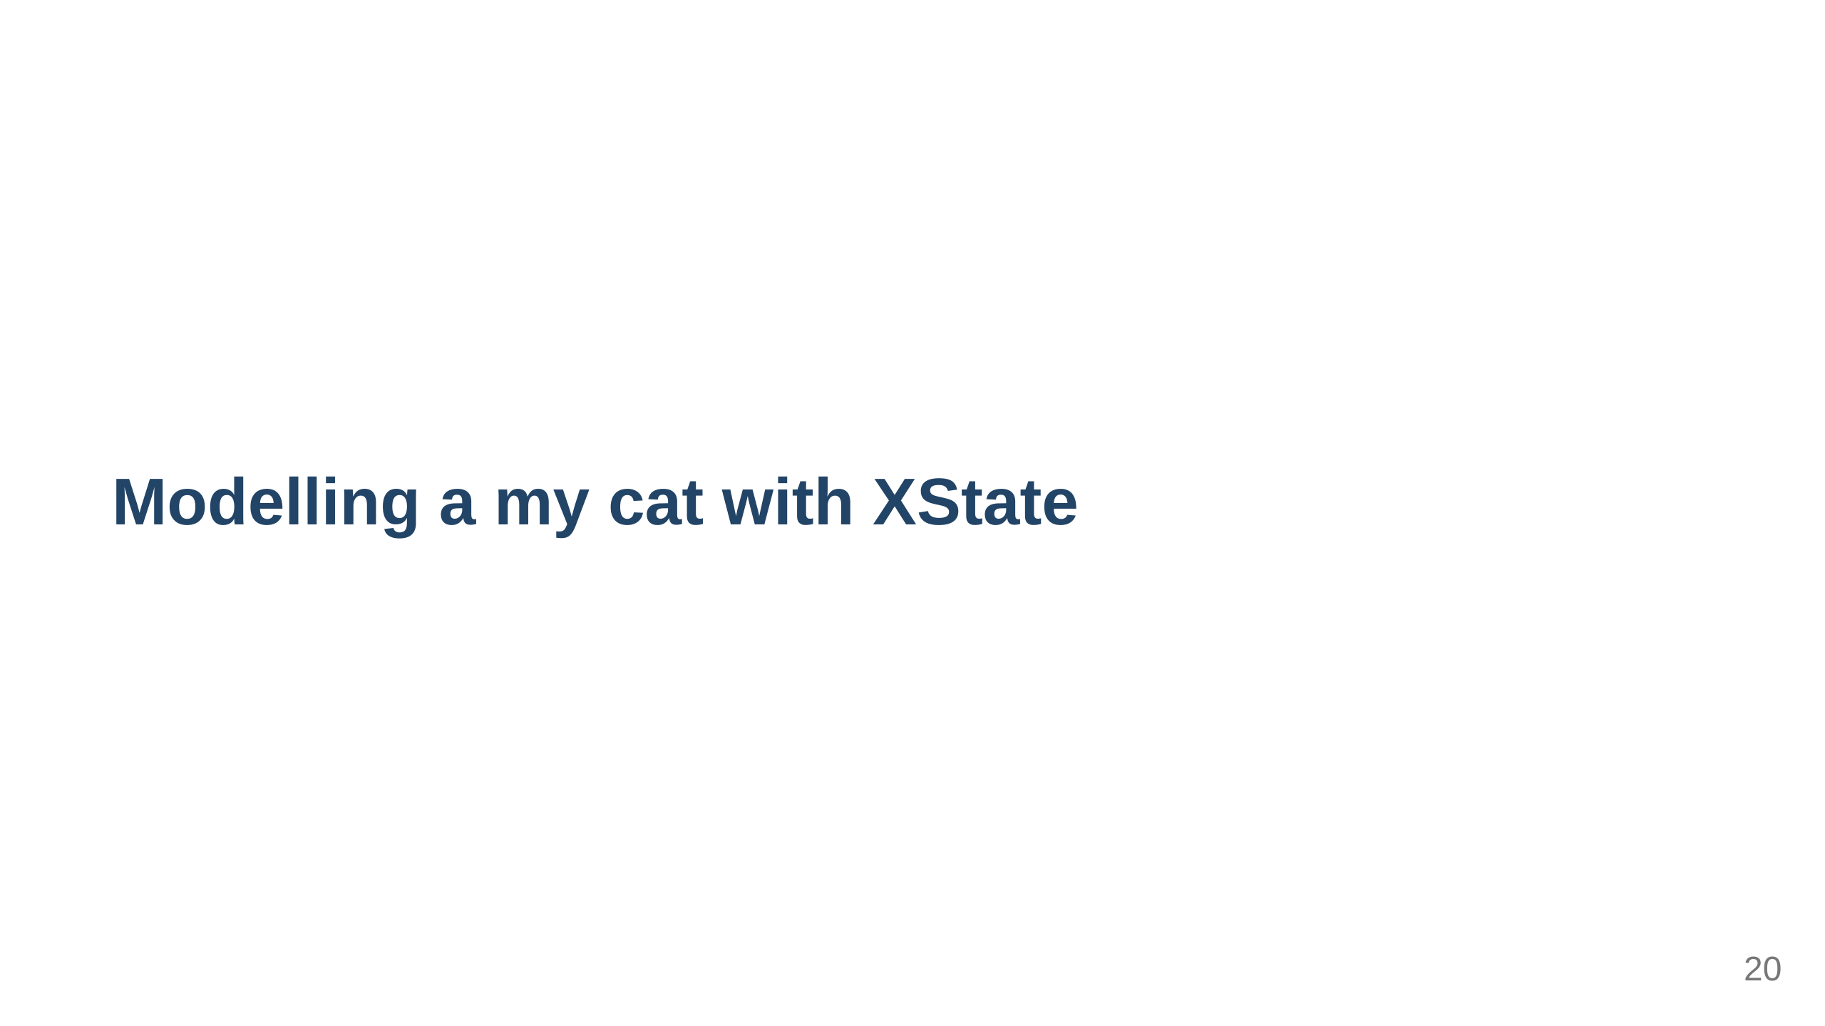

Slide 21

Notes:
1. First draw your finite state machine. I like excalidraw 2. Think of all the states 3. Think of the conditions 4. etc

Slide 22
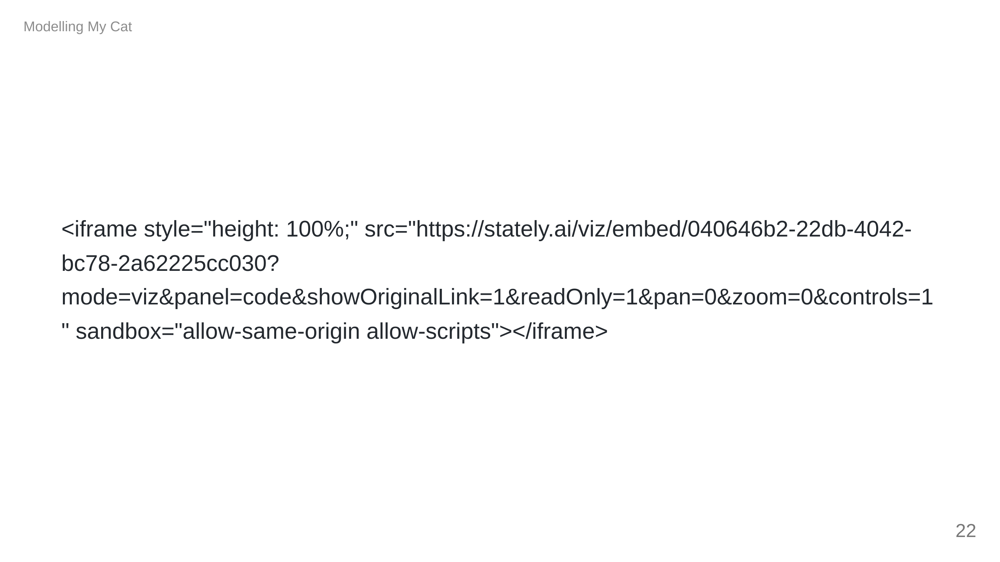

Slide 23
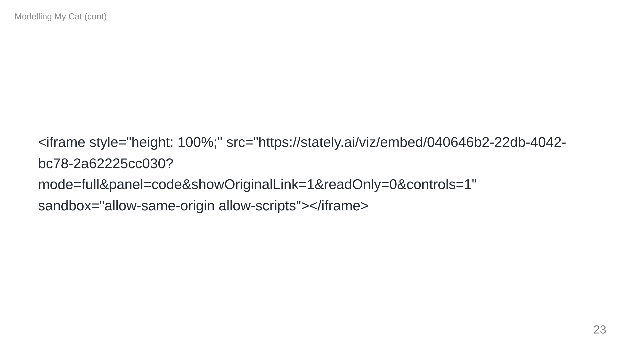

Slide 24
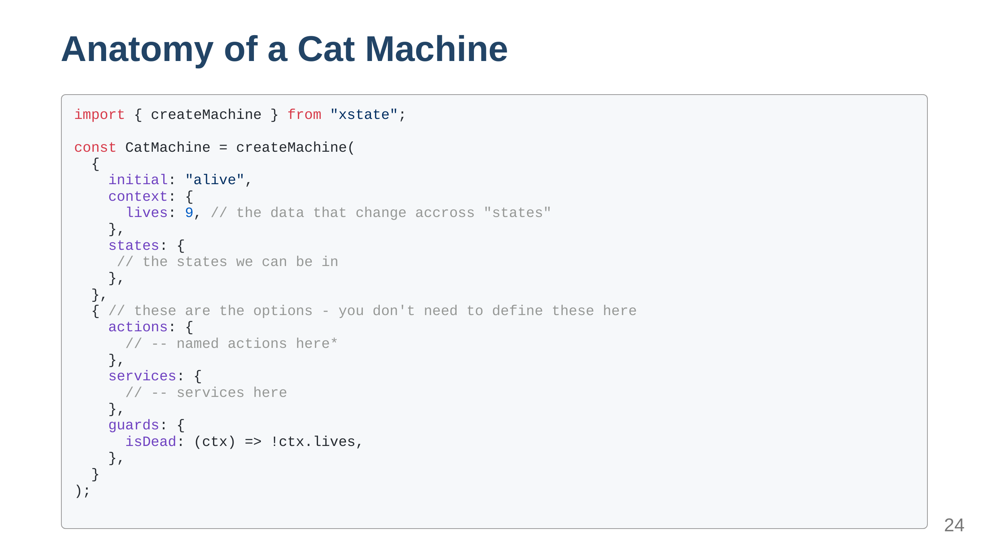

Slide 25
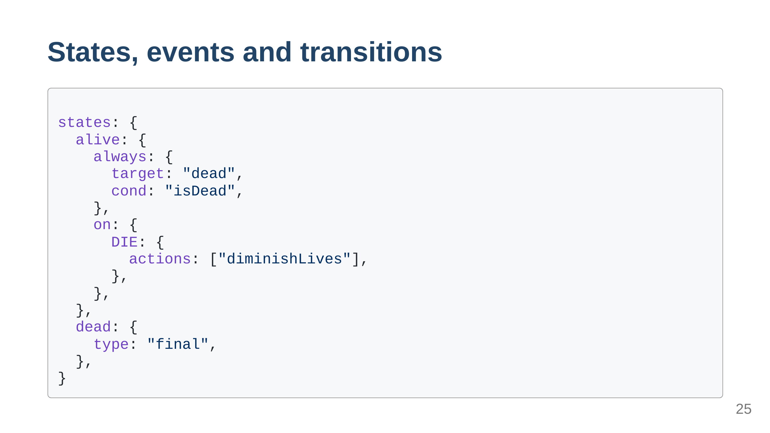
Notes:
always transition will get evaluated everytime we re-enter the state on defines all the possible transitions from an event type: 'final' states are states where evaluation ends.

Slide 26
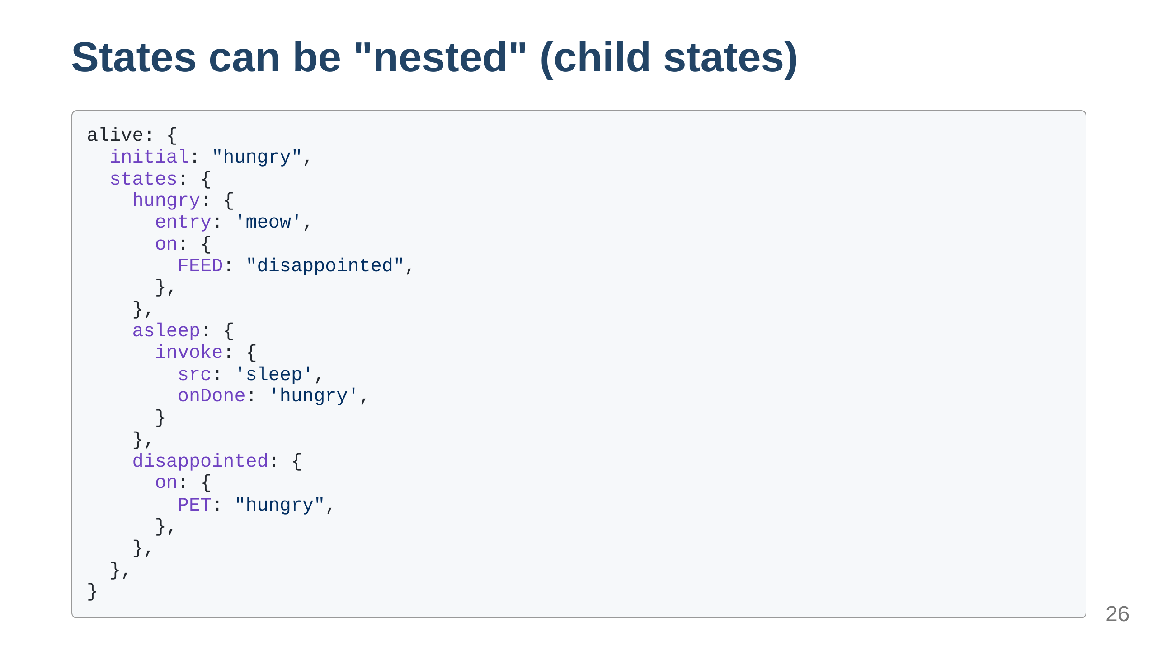

Slide 27
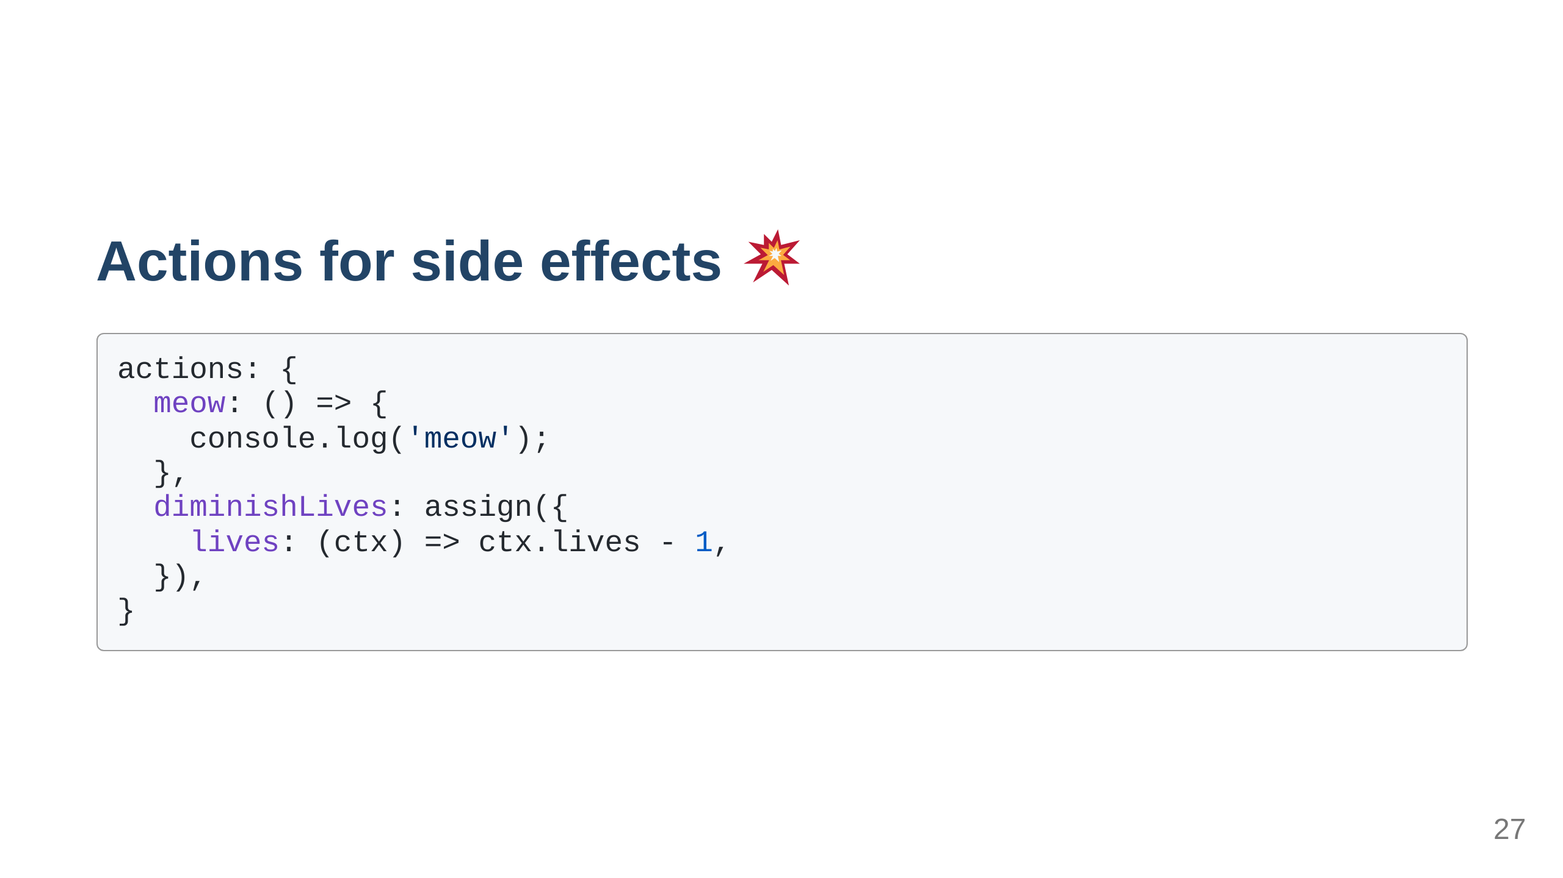
Notes:
Fire and foreget Logging something to the console Assigning a value to a variable Saving something to state (i.e. trigger a redux action?) Changing the attribute of a DOM node

Slide 28
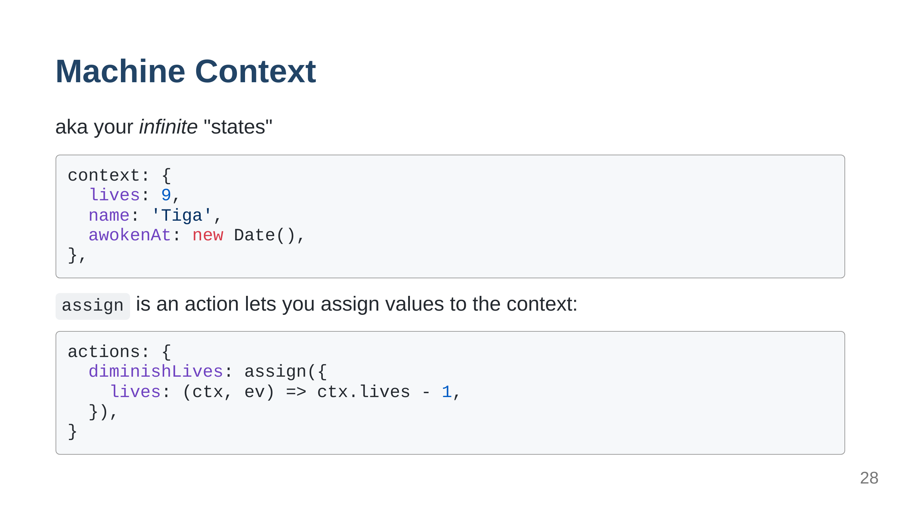
Notes:
States are used for handling your apps' states which you know about in advance. Context is a data store that you can use to store any arbitrary values. The assign action can be used to assign values to the context, and the context can be used in any action you call.

Slide 29
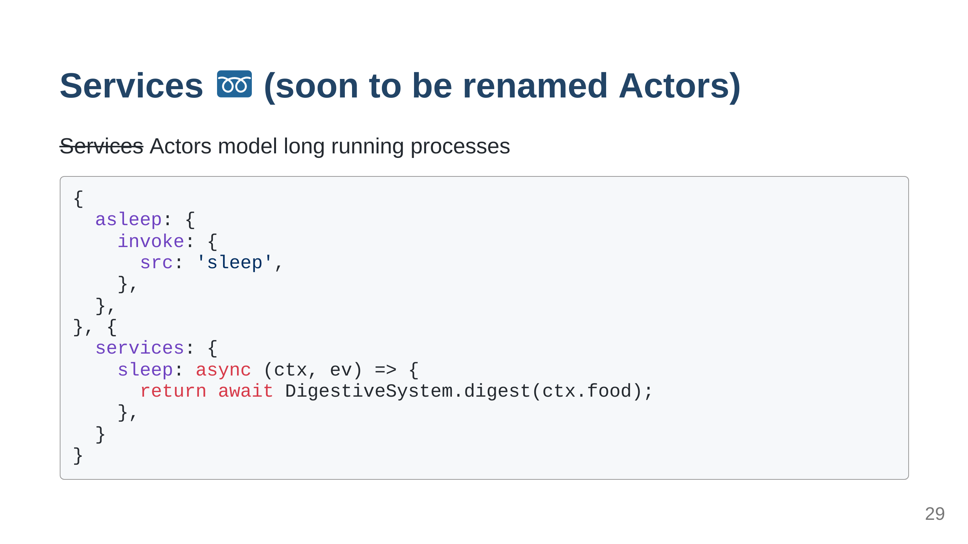
Notes:
- long running tasks - loading data, - promises - observables (i.e. websockets?) - other machines (composing)

Slide 30
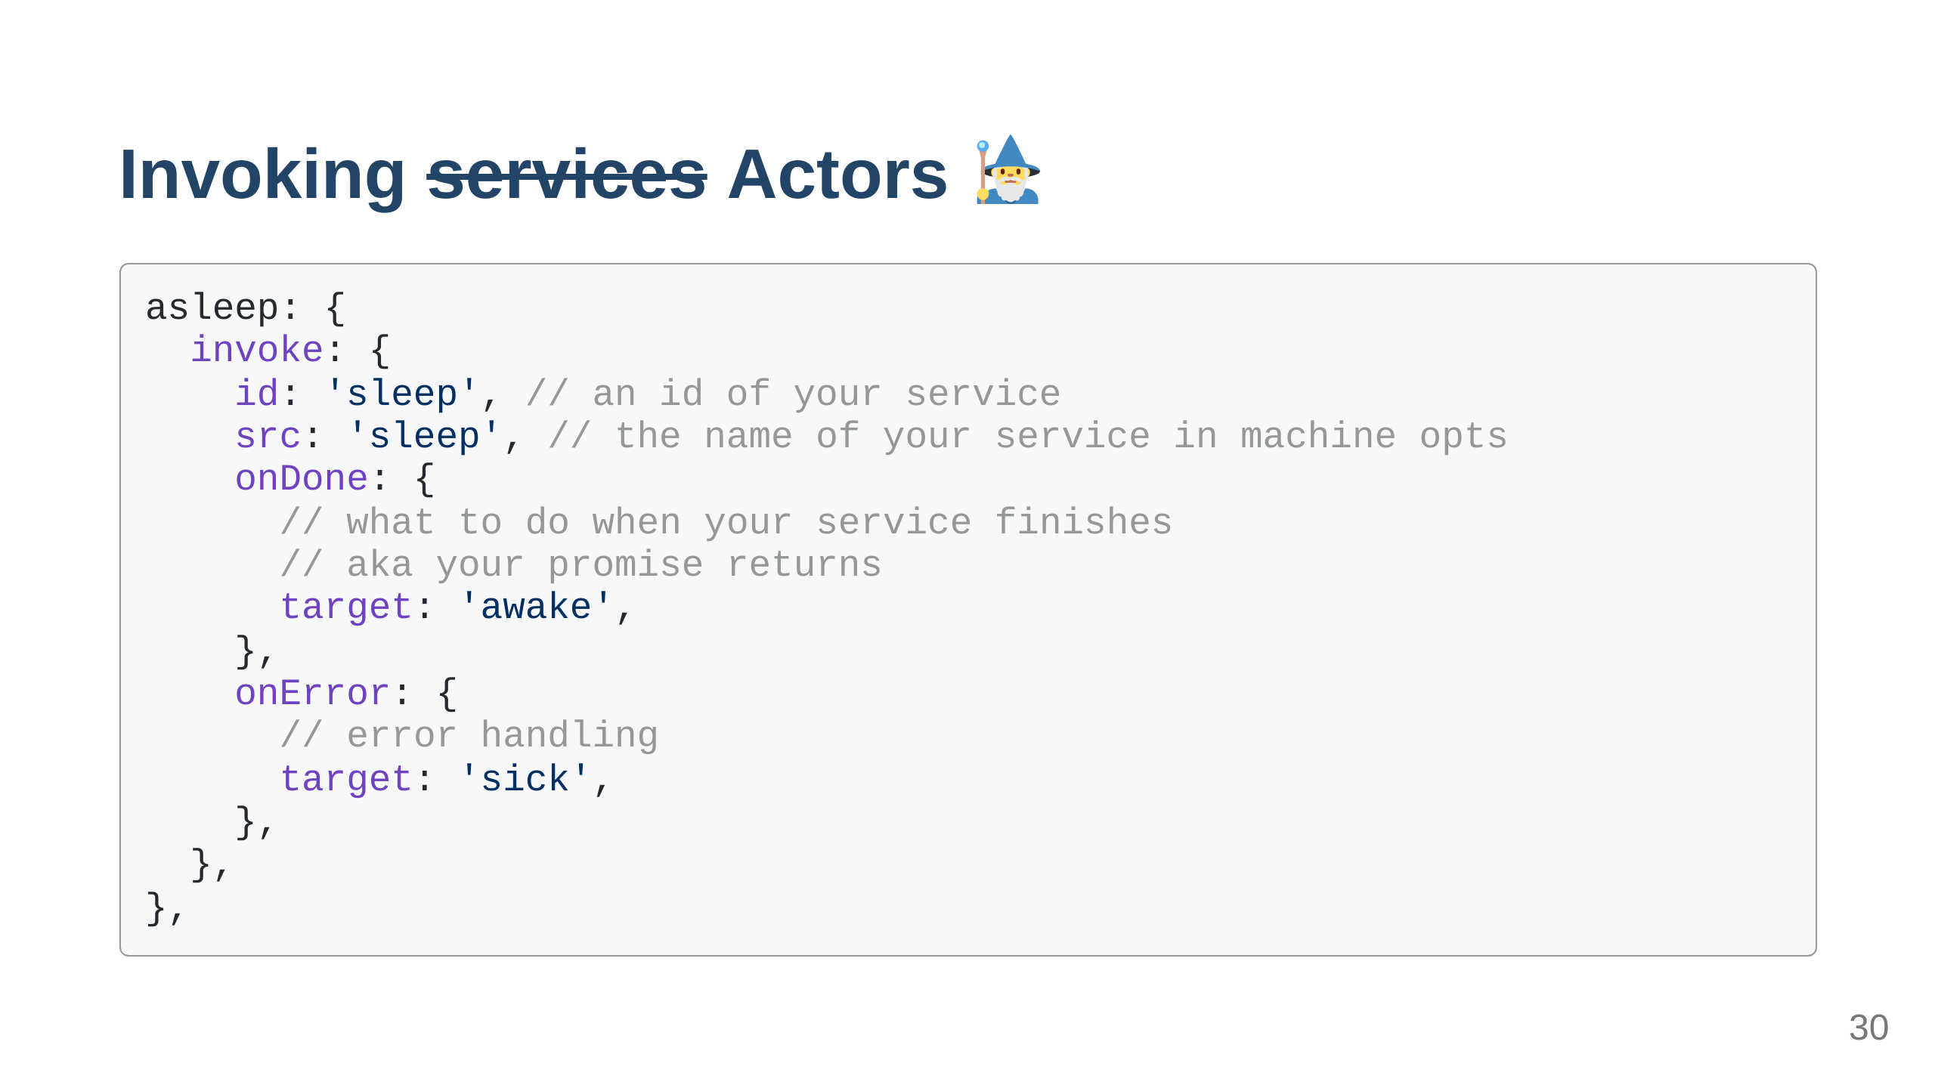
Notes:
- long running - async functions

Slide 31
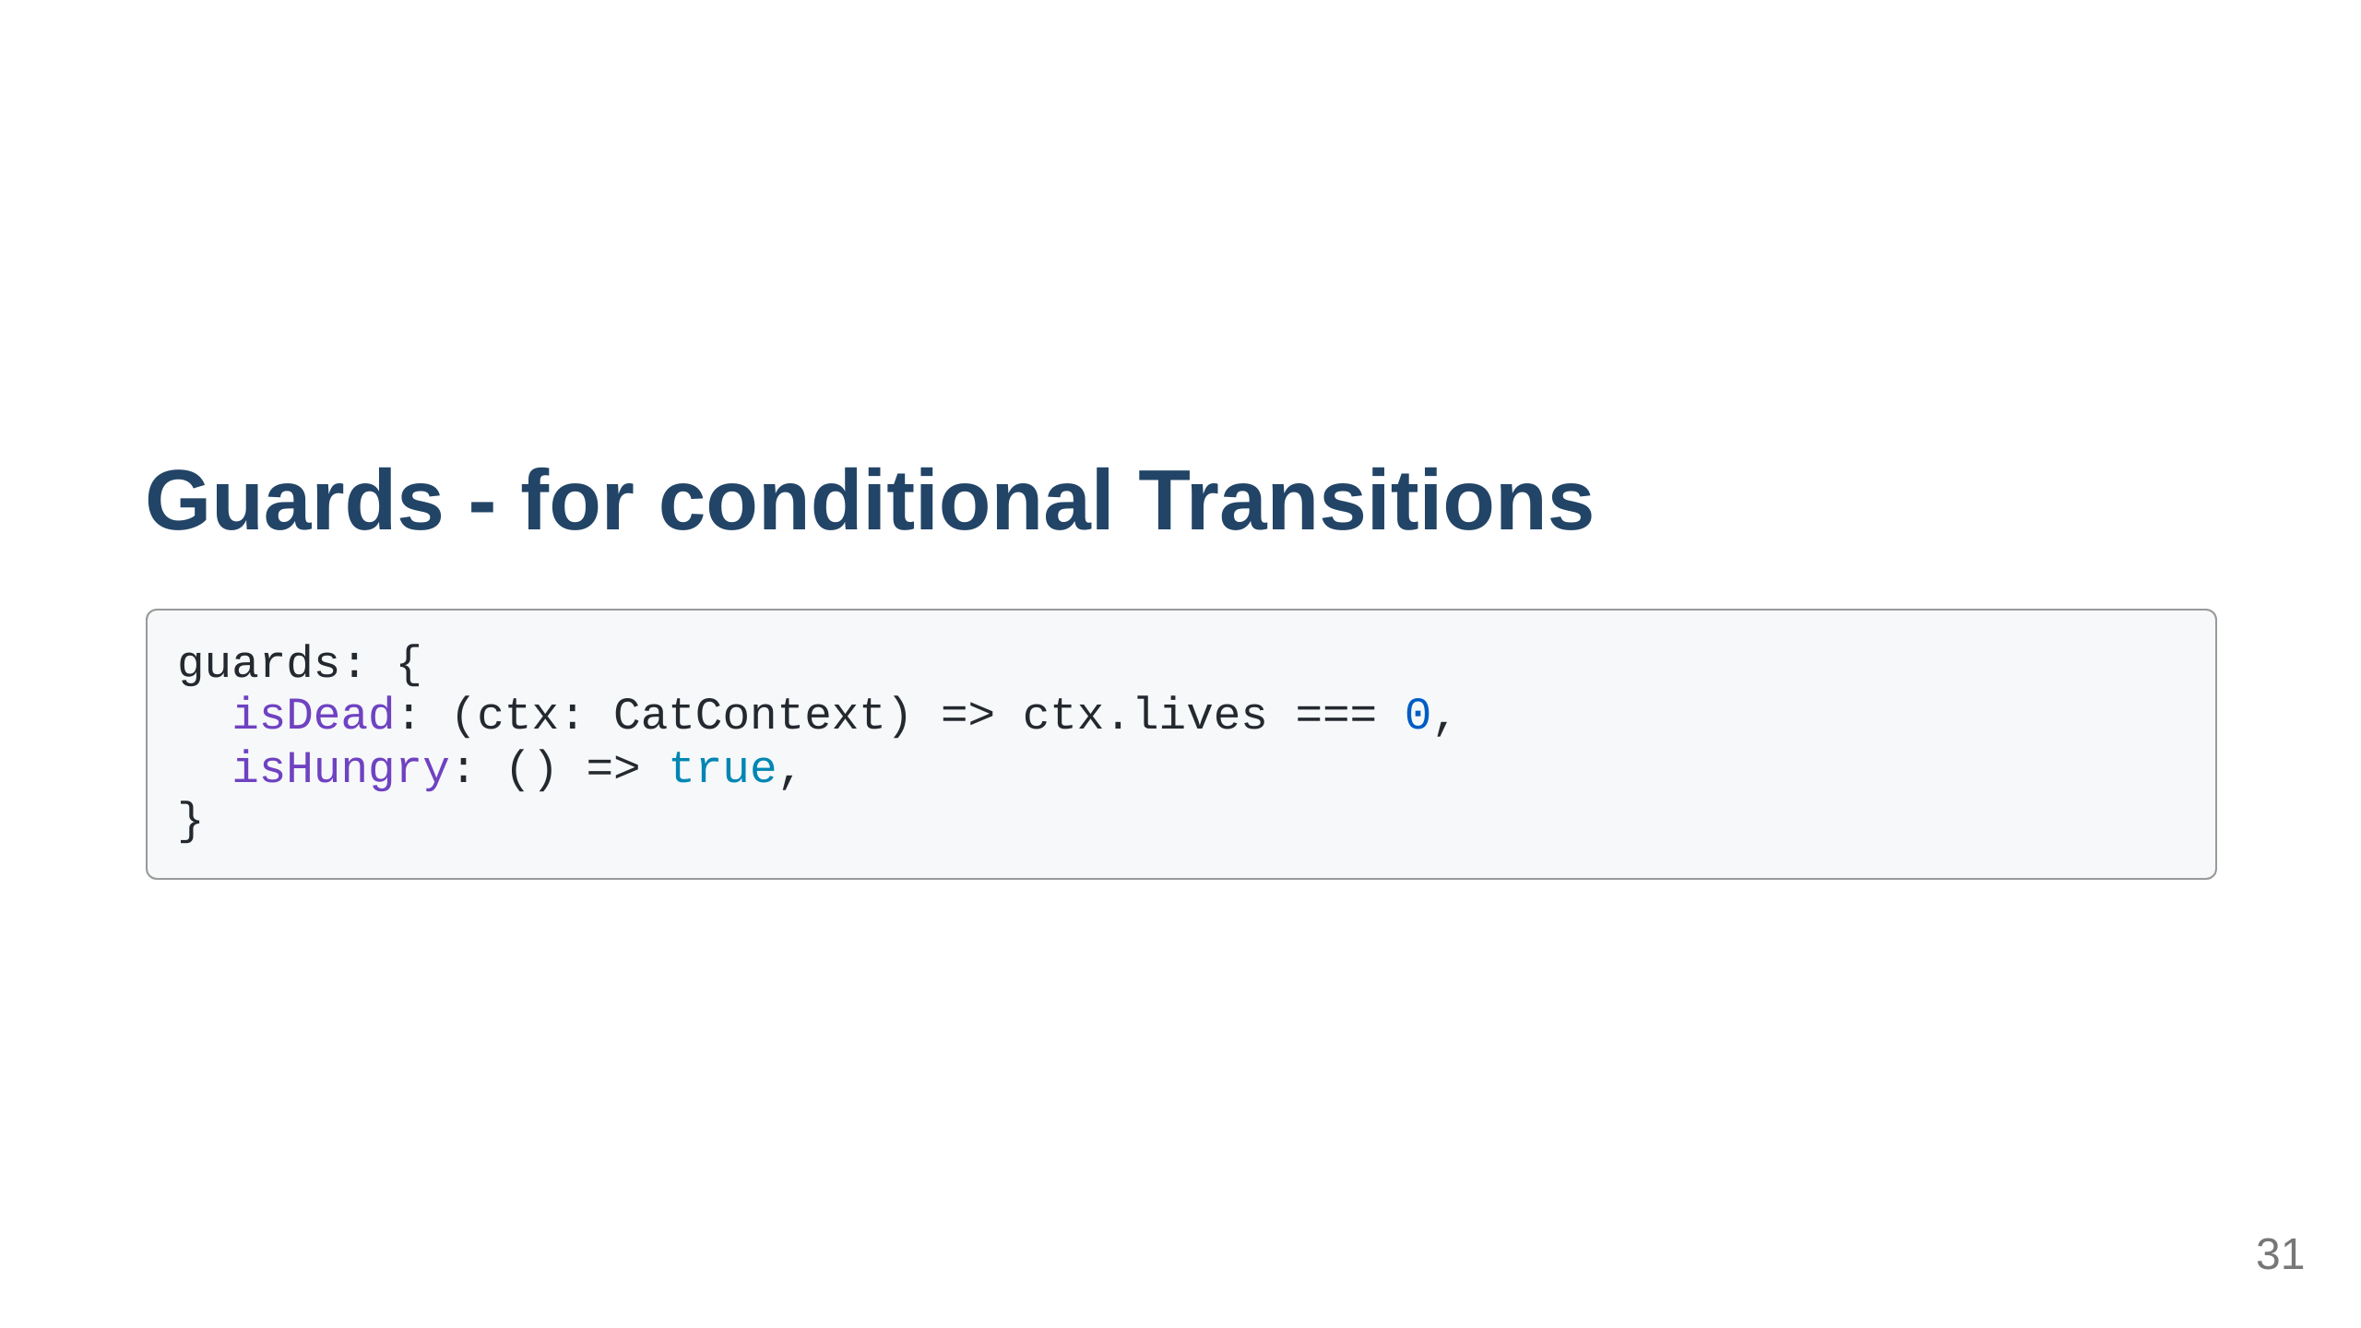

Slide 32

Notes:
I left out a ton of stuff there's other stuff like actors, hierarchical states parallel states

Slide 33
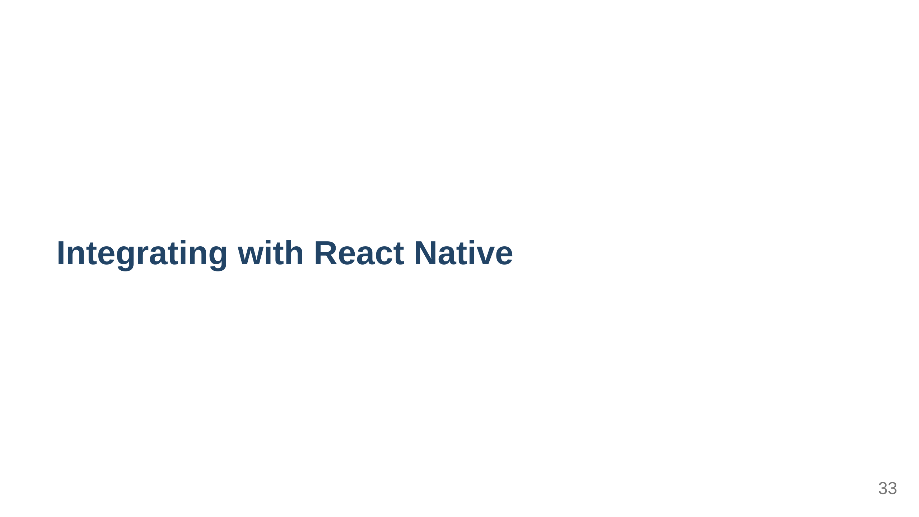
Notes:
no different than a regular react app just navigating between screens can be a bit tricky

Slide 34
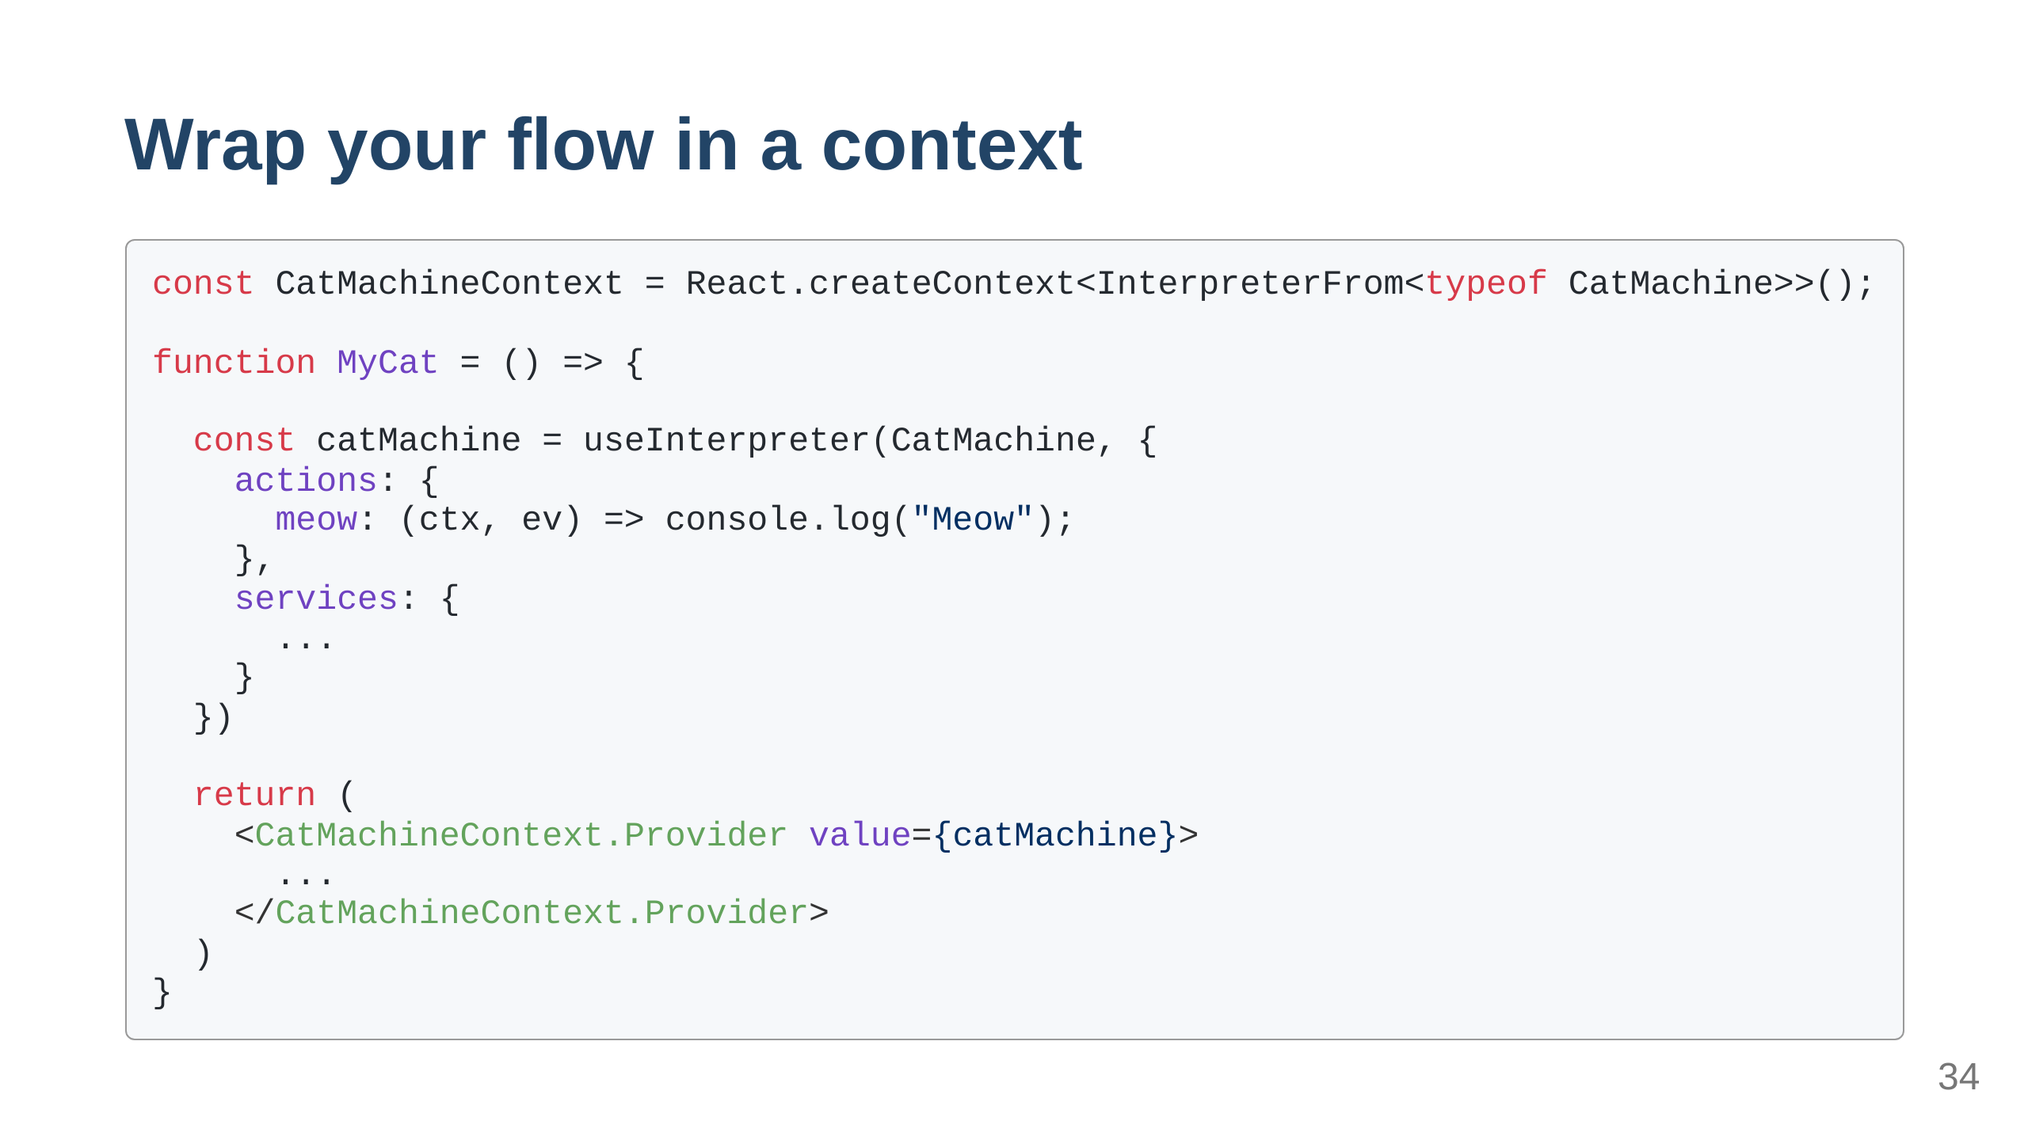

Slide 35
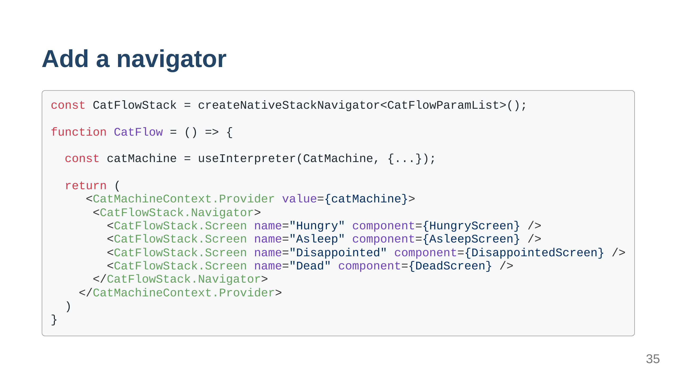

Slide 36
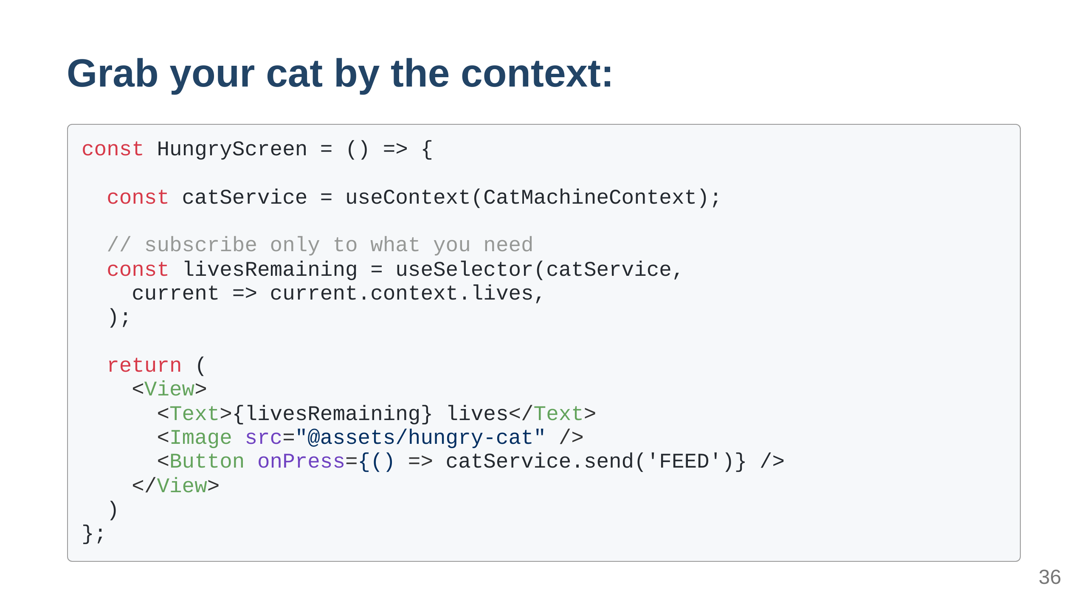
Notes:
the send function sends events to the machine

Slide 37
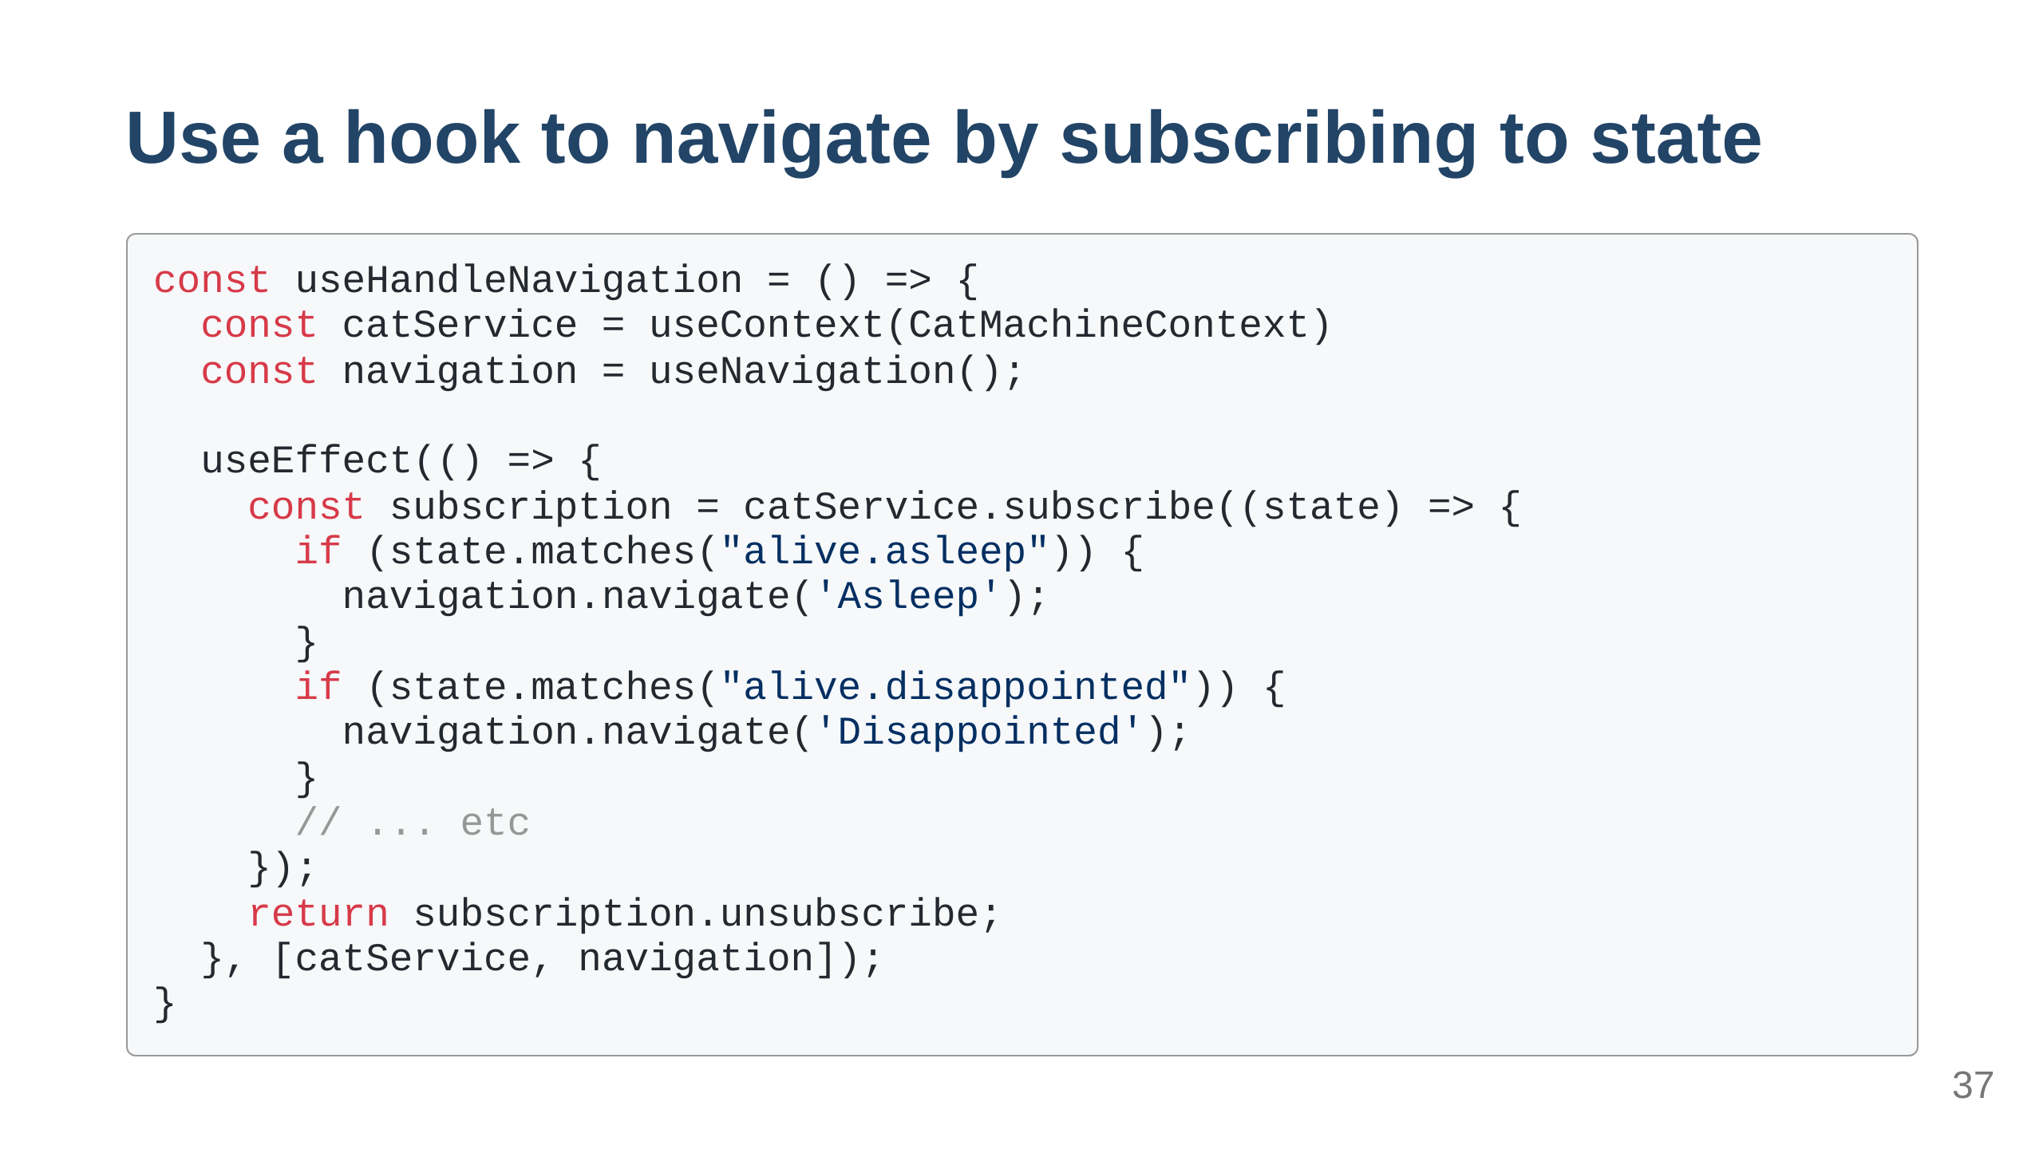
Notes:
this can be a bit cumbersome but also powerful. it's up to you to use this way

Slide 38
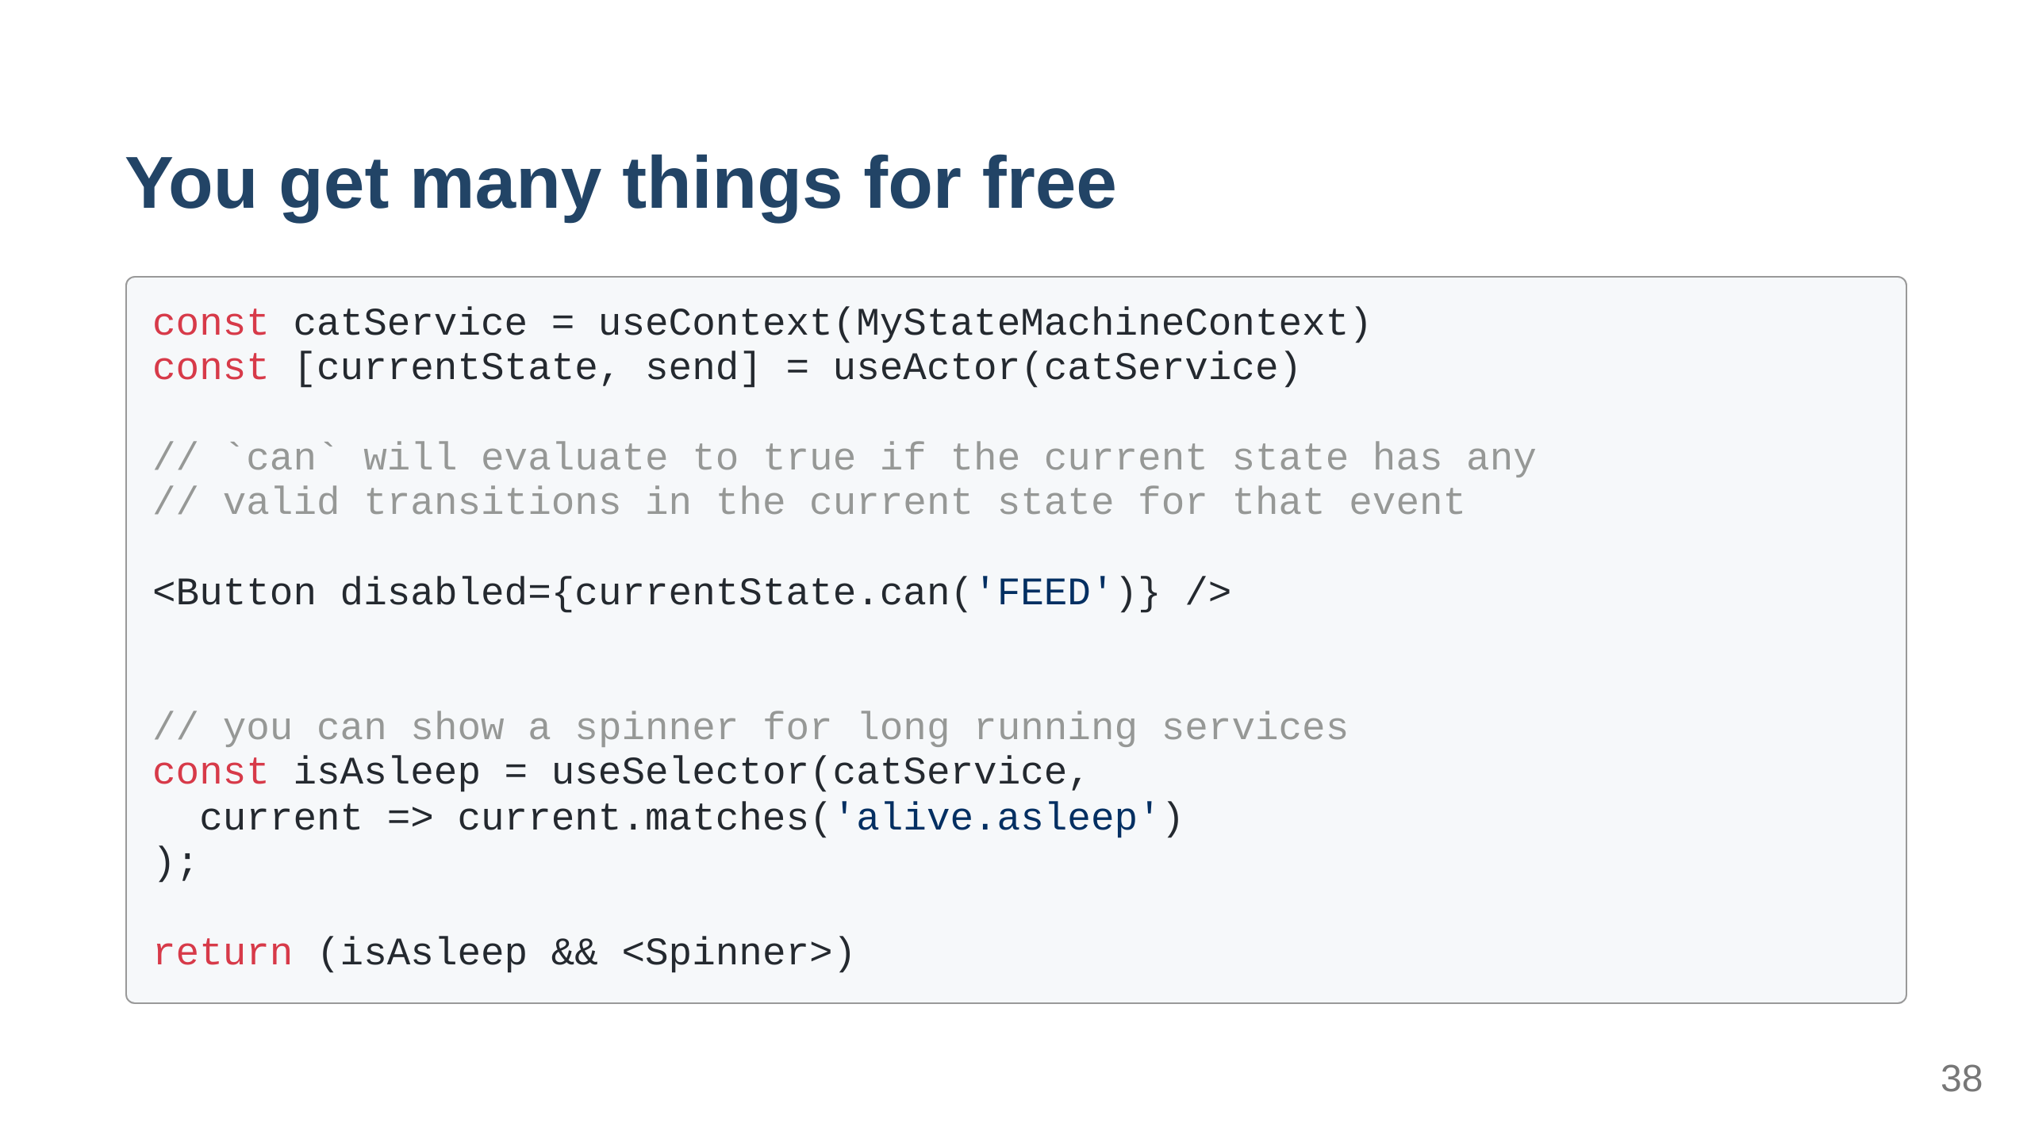

Slide 39
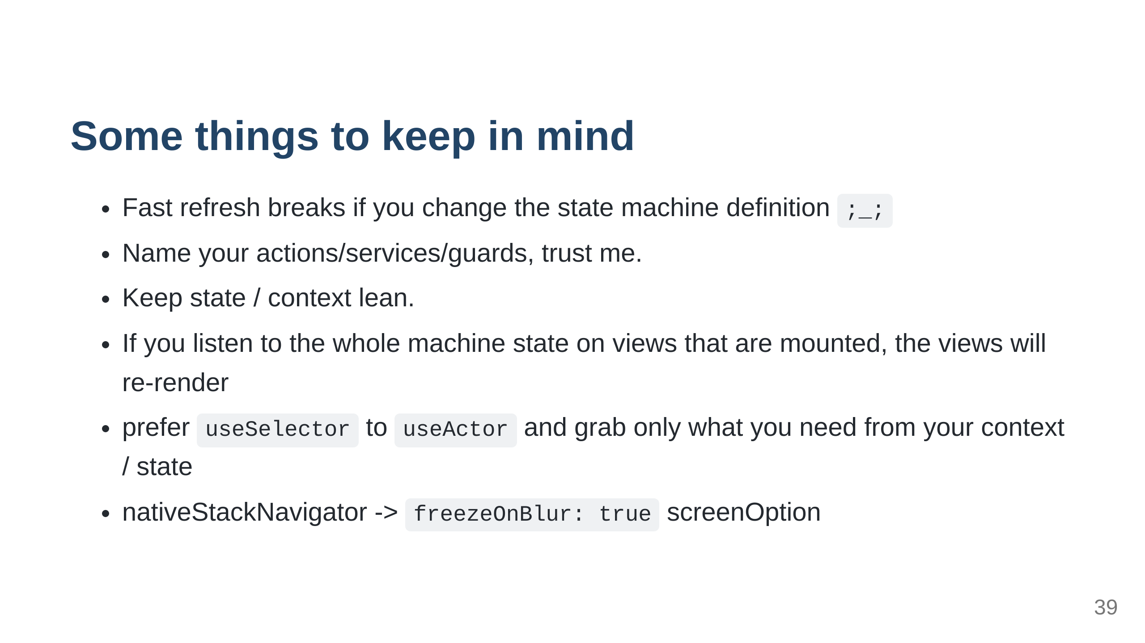

Slide 40


Slide 41
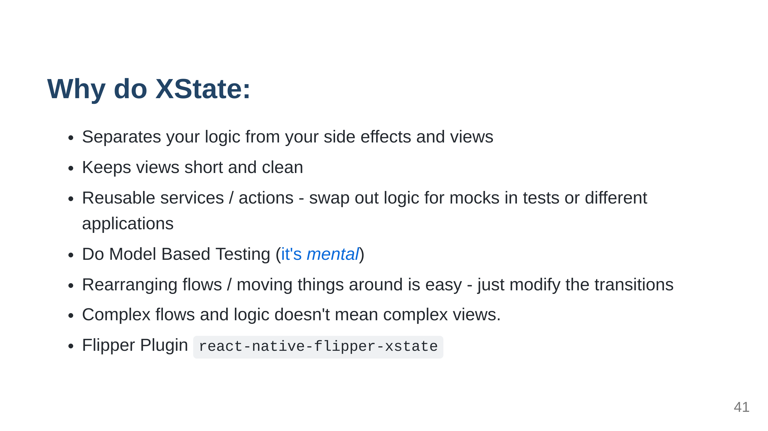

Slide 42
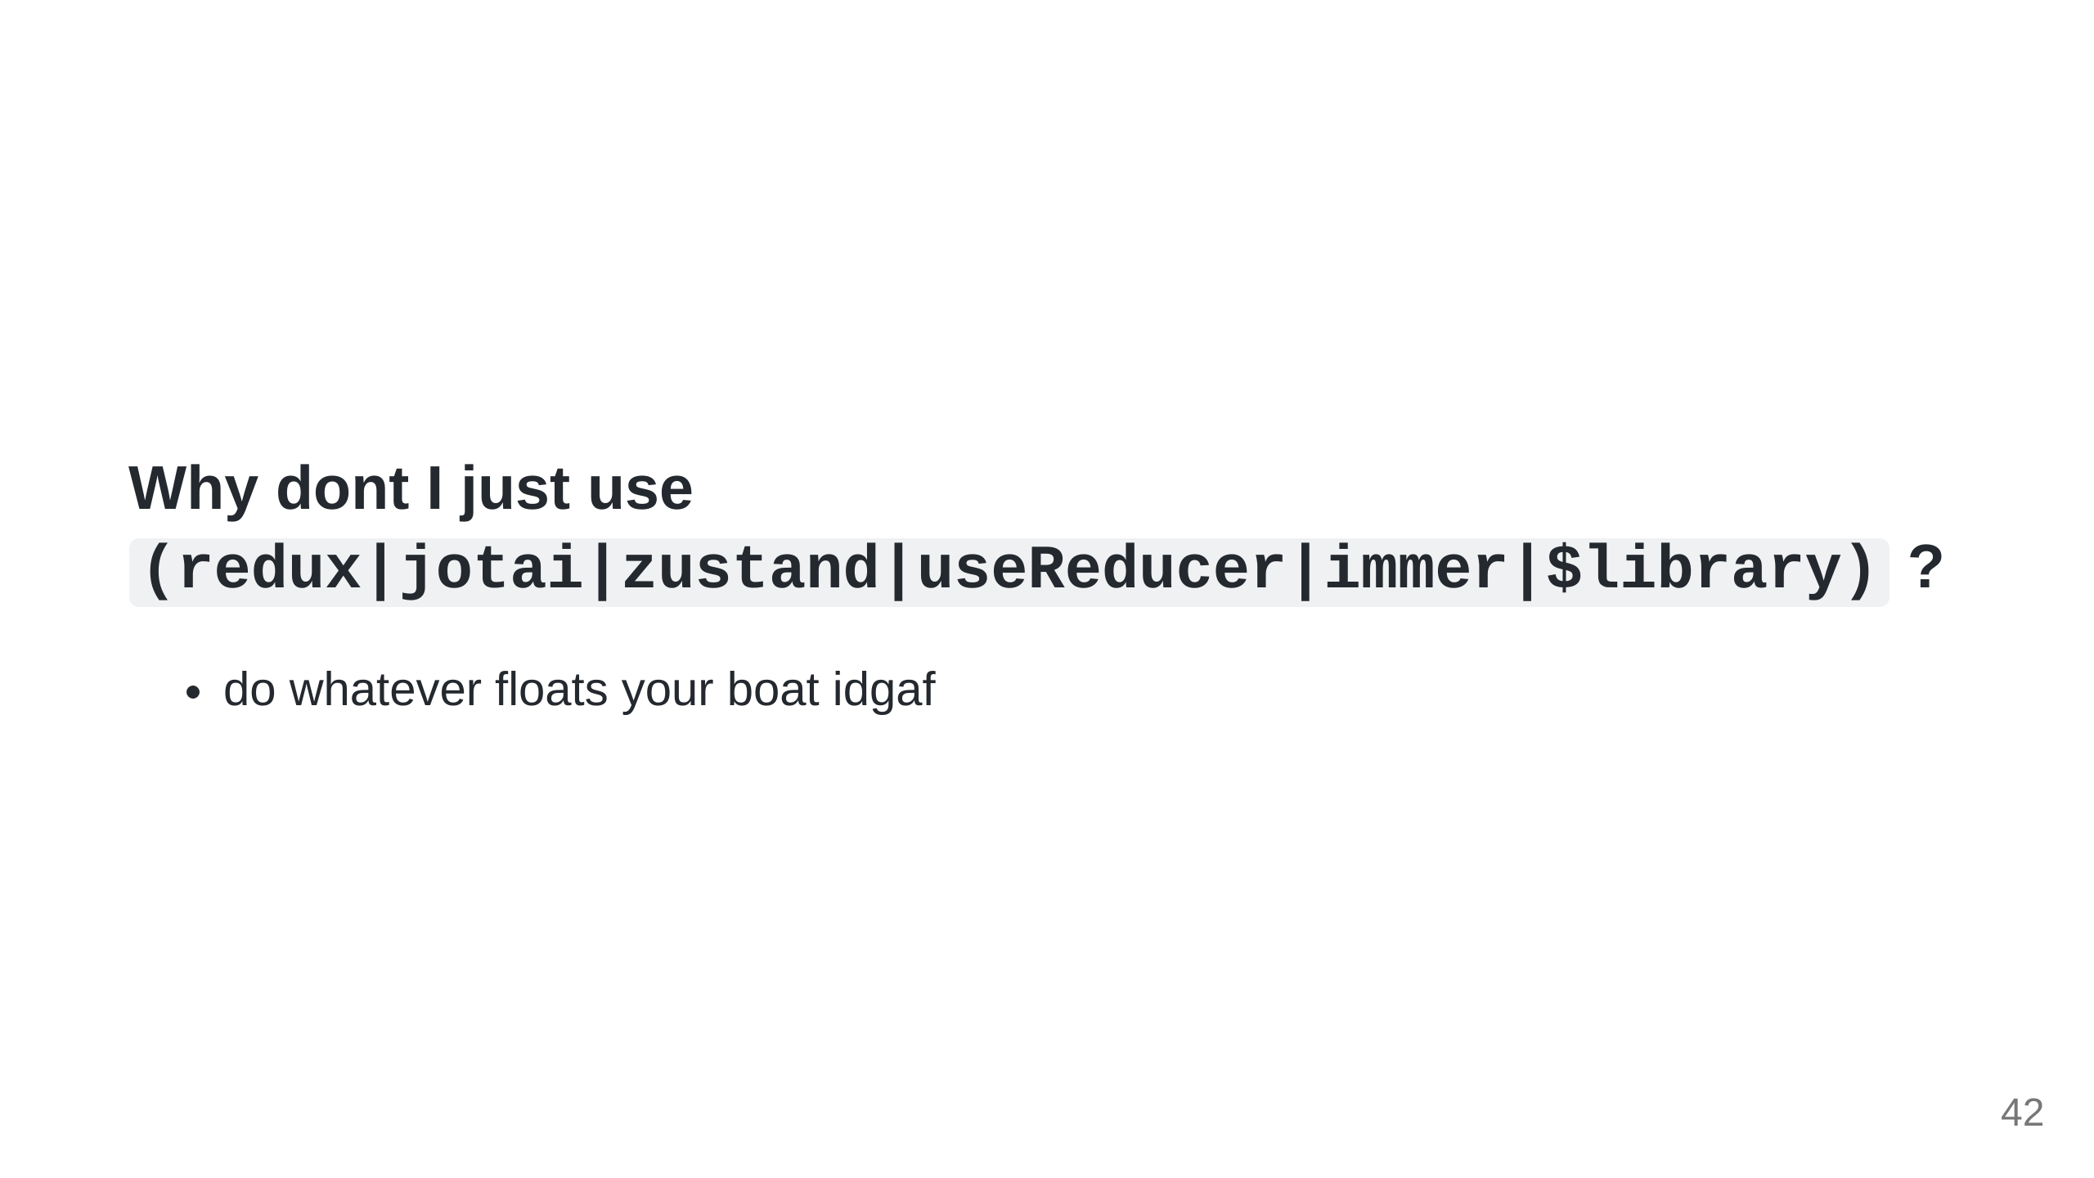
Notes:
also point out the fact that * Guess what you're using FSMs whether you like them or not

Slide 43
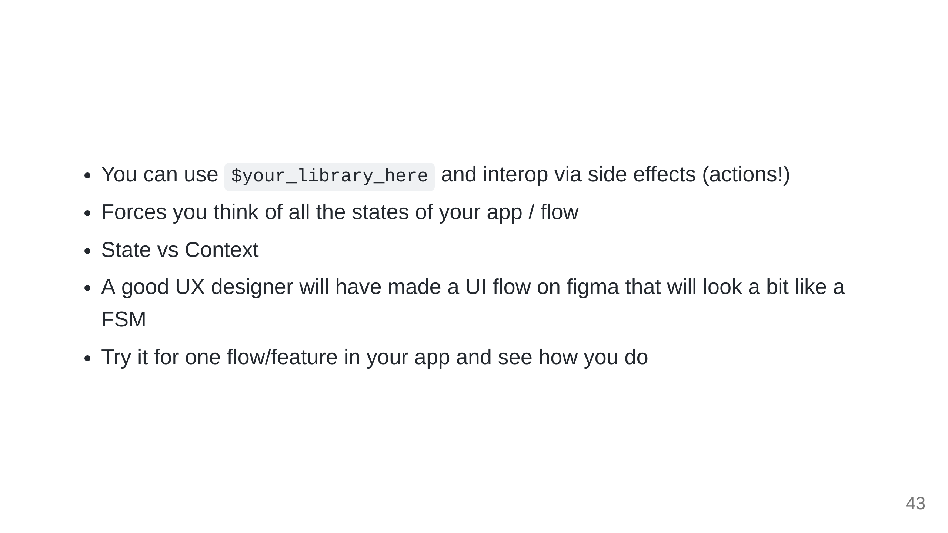
Notes:
you can have between=machine communication, or send things somewhere else via actions

Slide 44
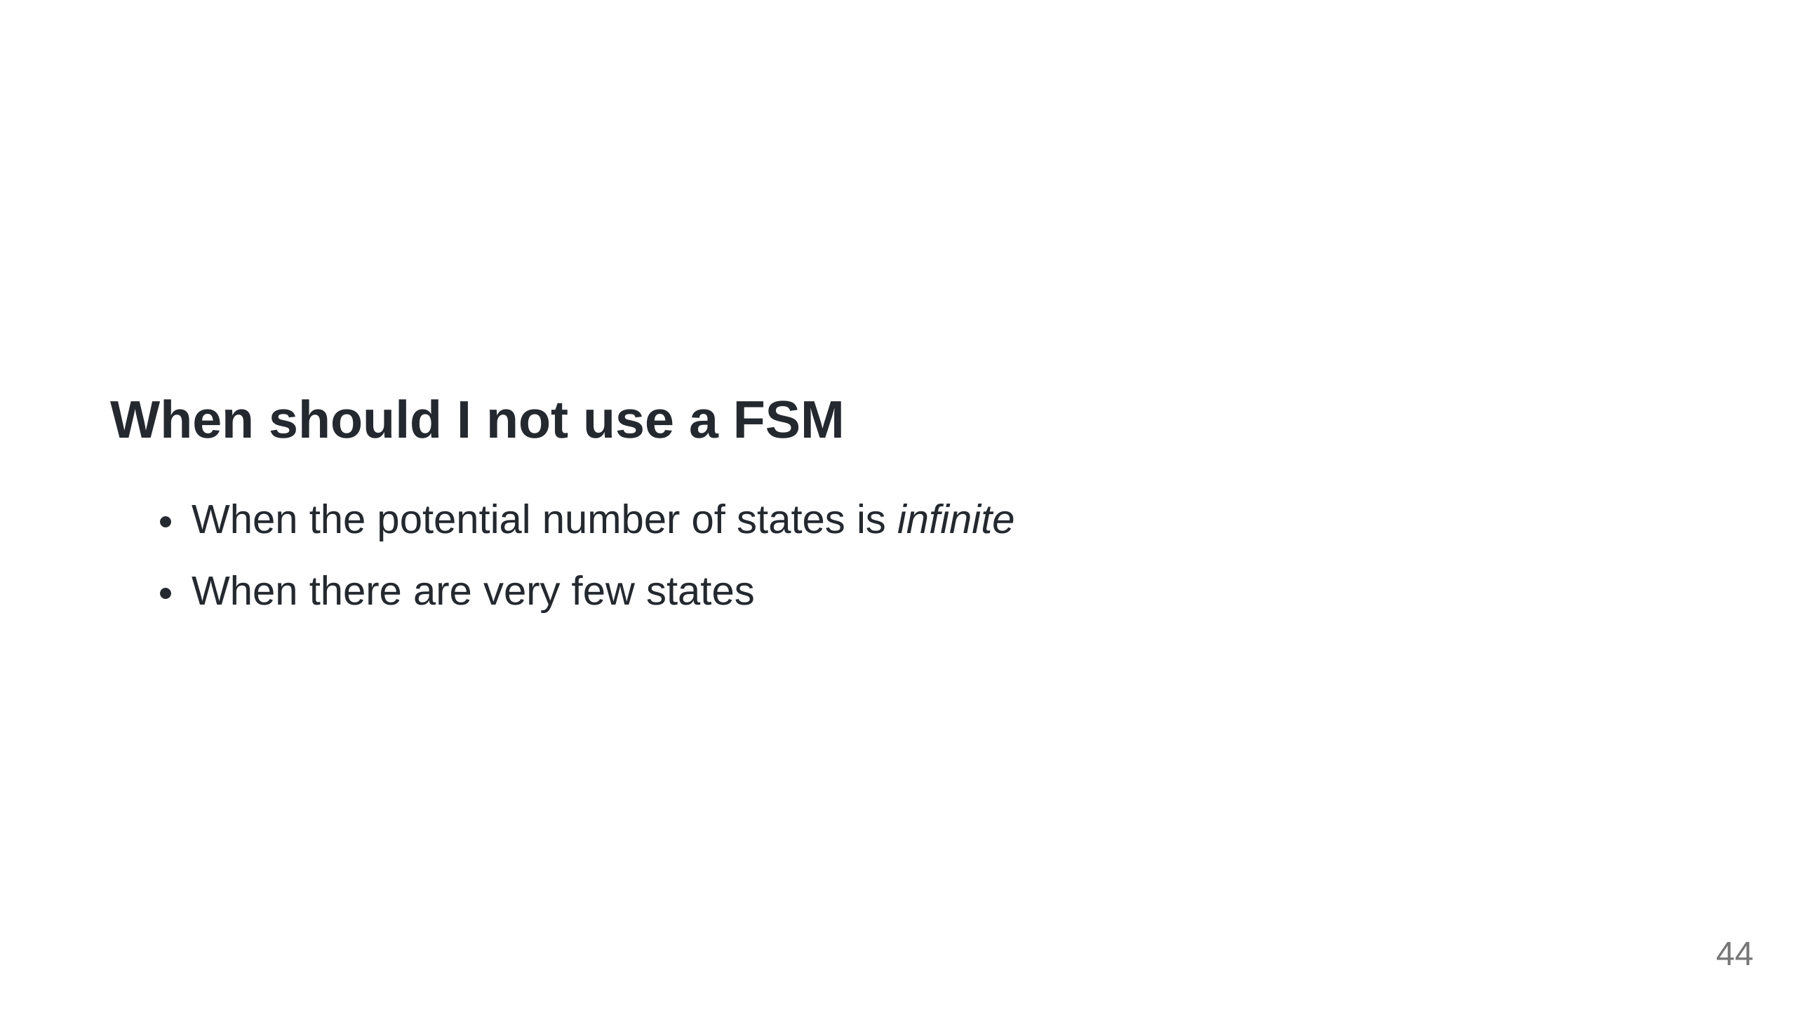

Slide 45


Slide 46


Slide 47
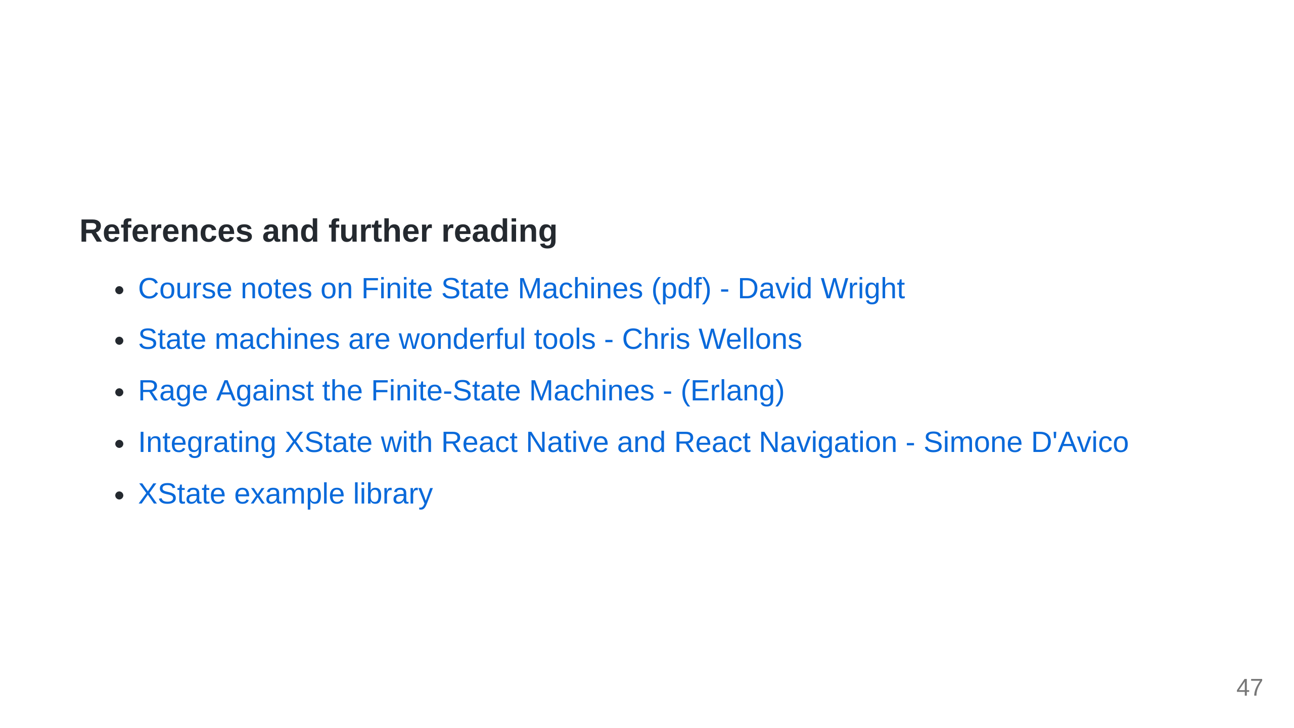

Slide 48


Slide 49


